Slide 1


Sample Catalogs,
Matrices and Diagrams v3: December 2011
Download the template bundle from http://www.opengroup.org/bookstore/catalog/i093.htm
V9.1 Edition Copyright © 2009-2011
All rights reserved
Published by The Open Group, 2011
The Open Group gratefully acknowledges the contributions
from SAP and Capgemini
Notes:
This module introduces the catalogs, matrices and diagrams for this phase

Slide 2

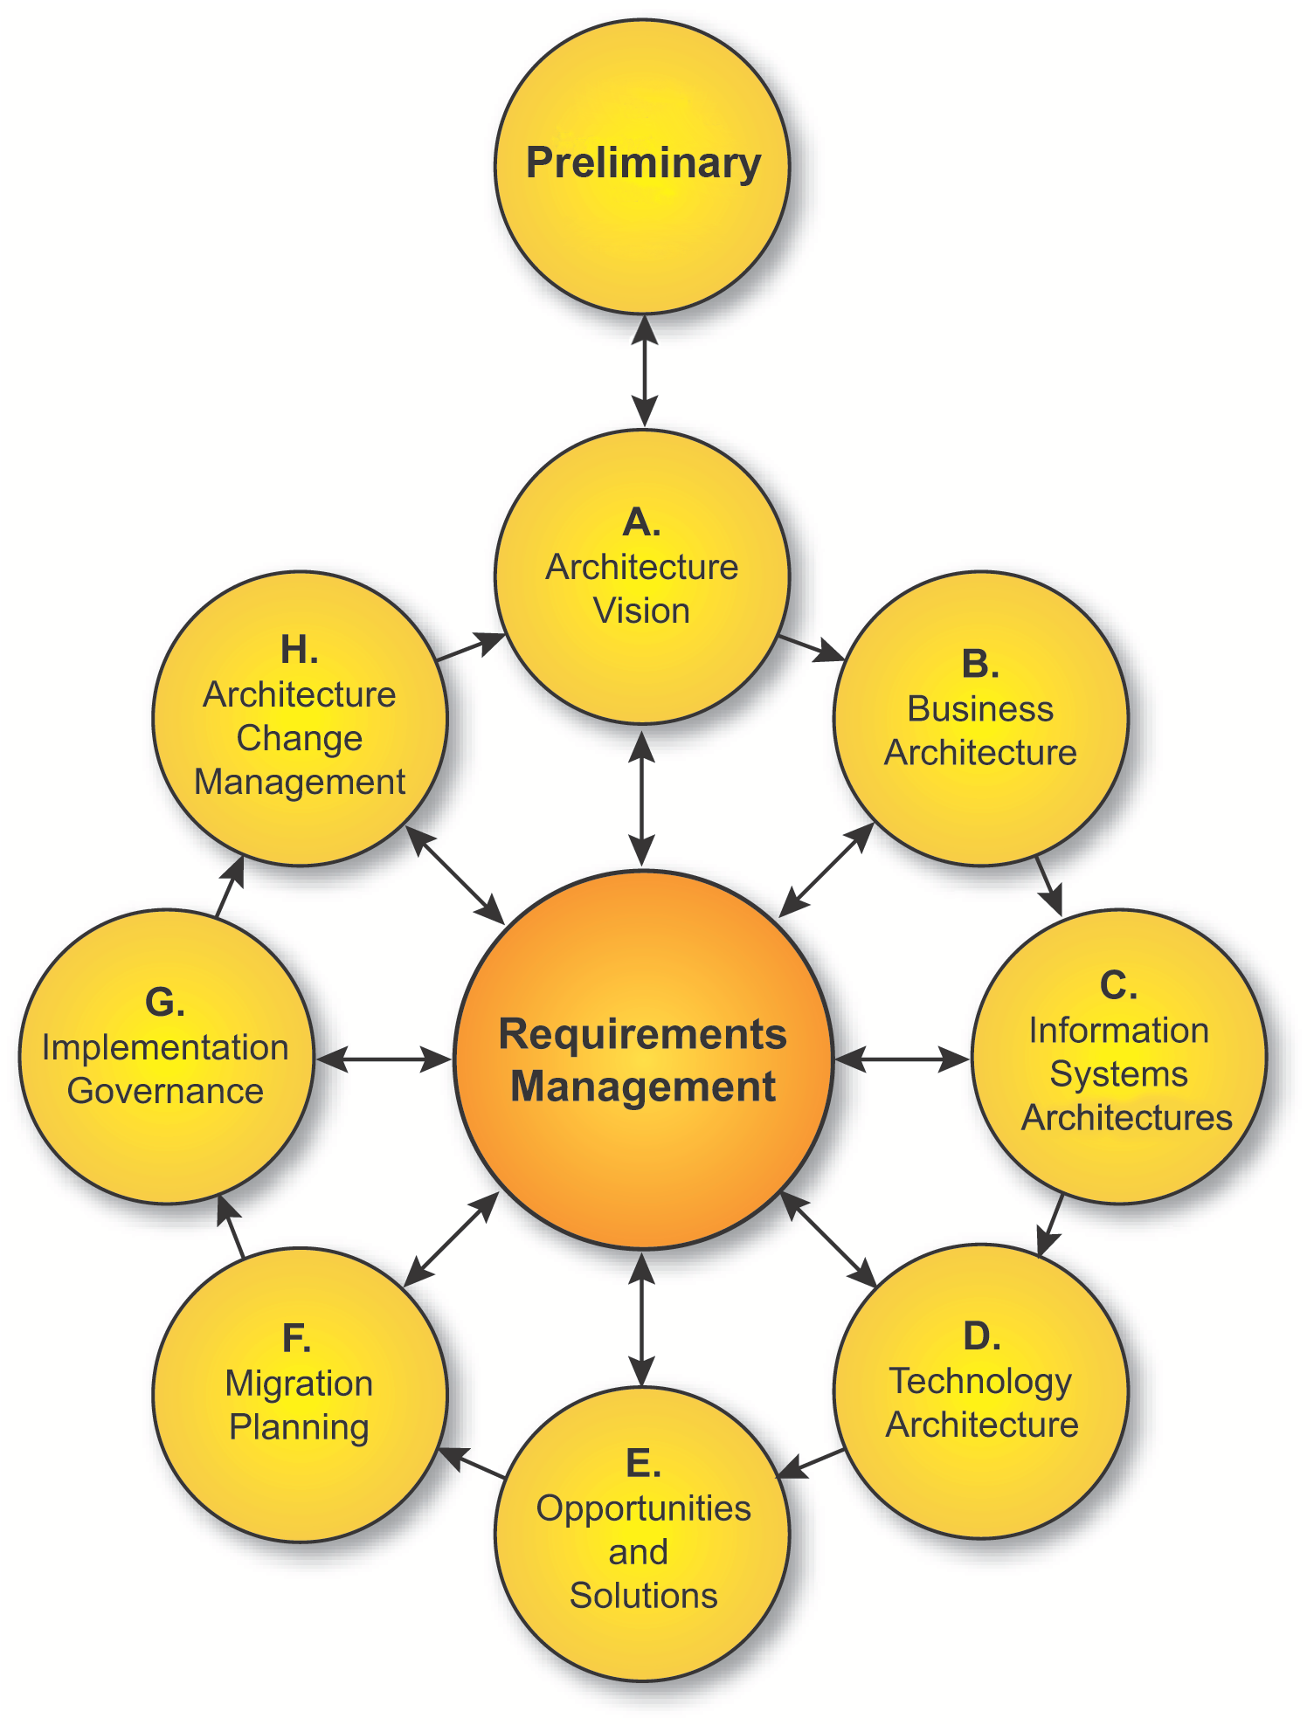
Sample Catalogs, Matrices and Diagrams
TOGAF is a registered trademark of The Open Group in the United States and other countries
Notes:
This is material added to part III in TOGAF 9, supporting the ADM with a collection of guidelines and techniques.

Slide 3
Objectives
The objectives of this presentation are to illustrate:
TOGAF 9 Catalogs, Matrices and Diagrams
What they consist of
Examples
How they can be used
The examples shown are illustrative. The exact format of the catalogs, matrices and diagrams will depend on the tools used and adaptations to TOGAF for the specific EA.
Notes:
See section 2.3.3 of the Pocket Guide and chapter 8 of TOGAF for details on Business Architecture.
The objectives of this module are as follows:
For this and each of the ADM phases this is an accompanying module that looks at the catalogs, matrices and diagrams

Slide 4
TOGAF 9 Artifacts
Preliminary Phase Principles catalog | Phase A, Architecture Vision
Requirements Management
Phase B, Business Architecture Organization/Actor catalog Driver/Goal/Objective catalog Role catalog Business Service/Function catalog Location catalog Process/Event/Control/Product catalog Contract/Measure catalog Business Interaction matrix Actor/Role matrix Business Footprint diagram Business Service/Information diagram Functional Decomposition diagram Product Lifecycle diagram Goal/Objective/Service diagram Business Use-Case diagram Organization Decomposition diagram Process Flow diagram Event diagram | Phase C, Data Architecture Data Entity/Data Component catalog Data Entity/Business Function matrix Application/Data matrix Logical Data diagram Data Dissemination diagram Data Security diagram Class Hierarchy diagram Data Migration diagram Data Lifecycle diagram | Phase C, Application Architecture Application Portfolio catalog Interface catalog Application/Organization matrix Role/Application matrix Application/Function matrix Application Interaction matrix Application Communication diagram Application and User Location diagram Application Use-Case diagram Enterprise Manageability diagram Process/Application Realization diagram Software Engineering diagram Application Migration diagram Software Distribution diagram | Phase D, Technology Architecture Technology Standards catalog Technology Portfolio catalog System/Technology matrix Environments and Locations diagram Platform Decomposition diagram Processing diagram Networked Computing/Hardware diagram Communications Engineering diagram
Phase E. Opportunities & Solutions Project Context diagram Benefits diagram
Stakeholder Map Matrix
Solution Concept diagram
Value Chain diagram
Requirements catalog
TOGAF 9 Artifacts
Notes:
A summary of the example artifacts included with TOGAF 9
These concepts are formally modeled in TOGAF 9
We’ll look at the artifacts as we go through the slides

Slide 5
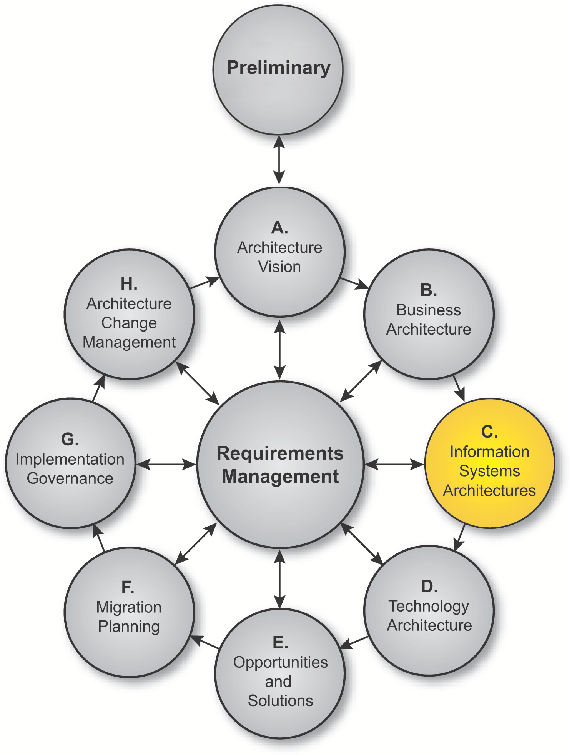
Phase C
Preliminary Phase – Catalogs, Matrices and Diagrams
TOGAF is a registered trademark of The Open Group in the United States and other countries
Notes:
See section 2.3.4.2 of the Pocket Guide and Chapter 11 of TOGAF.
The block diagram shows we are on Application Architecture, one of the four major types of architecture addressed by TOGAF (the colours chosen match those of the metamodel)

Slide 6
Preliminary Phase
Catalogs, Matrices and Diagrams
P
Catalogs
Principles Catalog
Matrices
Diagrams
Notes:
Catalogs capture inventories of the core assets of the Business. Catalogs are hierarchical in nature and capture the decomposition of a metamodel entity and also decompositions across related metamodel entities (e.g. organization → actor).
Catalogs form the raw material for development of matrices and diagrams and also act as a key resource for portfolio managing business and IT capability.
The Catalogs listed above are identified as being core to the definition of a Business Architecture
The structure of catalogs is based on the attributes of the contained metamodel entities as defined in Part IV.
Outcome:
Business Architecture Catalogs (a component of the Architecture Report)‏

Slide 7
Catalogs
Catalog
Purpose
Principles
Catalog
The Principles catalog captures principles of the business and architecture principles that describe what a "good" solution or architecture should look like. Principles are used to evaluate and agree an outcome for architecture decision points. Principles are also used as a tool to assist in architectural governance of change initiatives.
The Principles catalog contains the following metamodel entities:
* Principle
Notes:
Organization/Actor Catalog
The Organization/Actor catalog can be referenced when developing requirements in order to test for completeness.
Driver/Goal/Objectives catalog
Publishing a definitive breakdown of drivers, goals, and objectives allows change initiatives within the enterprise to identify synergies across the organization (e.g., multiple organizations attempting to achieve similar objectives), which in turn allow stakeholders to be identified and related change initiatives to be aligned or consolidated.
Role Catalog
If roles are defined, understood, and aligned across organizations and applications, this allows for a more seamless user experience and generally more secure applications, as administrators do not need to resort to workarounds in order to enable users to carry out their jobs.
In addition to supporting security definition for the enterprise, the Role catalog also forms a key input to identifying organizational change management impacts, defining job functions, and executing end-user training.
As each role implies access to a number of business functions, if any of these business functions are impacted, then change management will be required, organizational responsibilities may need to be redefined, and retraining may be needed.

Slide 8
Phase C
Phase A: Architecture Vision – Catalogs, Matrices and Diagrams
TOGAF is a registered trademark of The Open Group in the United States and other countries
Notes:
See section 2.3.4.2 of the Pocket Guide and Chapter 11 of TOGAF.
The block diagram shows we are on Application Architecture, one of the four major types of architecture addressed by TOGAF (the colours chosen match those of the metamodel)

Slide 9
Architecture Vision
Catalogs, Matrices and Diagrams
A
Catalogs
Matrices
Stakeholder Map Matrix
Diagrams
Value Chain Diagram
Solution Concept Diagram
Notes:
Catalogs capture inventories of the core assets of the Business. Catalogs are hierarchical in nature and capture the decomposition of a metamodel entity and also decompositions across related metamodel entities (e.g. organization → actor).
Catalogs form the raw material for development of matrices and diagrams and also act as a key resource for portfolio managing business and IT capability.
The Catalogs listed above are identified as being core to the definition of a Business Architecture
The structure of catalogs is based on the attributes of the contained metamodel entities as defined in Part IV.
Outcome:
Business Architecture Catalogs (a component of the Architecture Report)‏

Slide 10
Stakeholder Map
Stakeholder | Key Concerns | Class | Catalogs, Matrices and Diagrams
CxO | The high-level drivers, goals and objectives of the organization, and how these are translated into an effective process and IT architecture to advance the business | Keep Satisfied | Business Footprint diagram Goal/Objective/Service diagram Organization Decomposition diagram
Program Management Office | Prioritizing, funding, and aligning change activity. An understanding of project content and technical dependencies adds a further dimension of richness to portfolio management and decision making. | Keep Satisfied | Project Context diagram Business Footprint diagram Application Communication diagram Functional Decomposition diagram
HR | The roles and Actors that support the functions, applications, and technology of the organization. HR are important stakeholders in ensuring that the correct roles and actors are represented. | Keep Informed | Organization Decomposition diagram Organization/Actor catalog Location catalog
Notes:
The major product resulting from this step is a stakeholder map for the engagement, showing which stakeholders are involved with the engagement, their level of involvement, and their key concerns (see Part III, Steps in the Stakeholder Management Process and Template Stakeholder Map).
The stakeholder map is used to support various outputs of the Architecture Vision phase, and to identify:
*The concerns and viewpoints that are relevant to this project; this is captured in the Architecture Vision (see Part IV, Architecture Vision)
*The stakeholders that are involved with the project and as a result form the starting point for a Communications Plan (see Part IV, Communications Plan)
*The key roles and responsibilities within the project, which should be included within the Statement of Architecture Work (see Part VII, Statement of Architecture Work)
An example Stakeholder map (extract of) is shown on this slide
Understanding stakeholders and their requirements allows an architect to focus effort in areas that meet the needs of stakeholders (see Part III, Stakeholder Management).
Due to the potentially sensitive nature of stakeholder mapping information and the fact that the Architecture Vision phase is intended to be conducted using informal modeling techniques, no specific metamodel entities will be used to generate a stakeholder map.

Slide 11
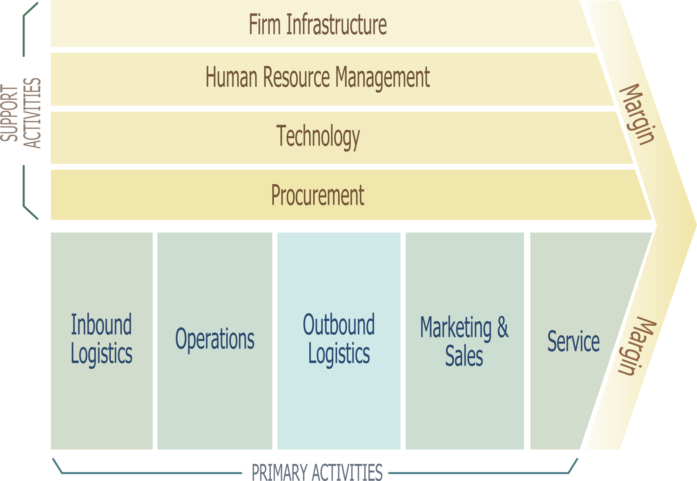
Value Chain Diagram
Source: Wikipedia.org
Notes:
(Source Wikipedia)
The value chain, also known as value chain analysis, is a concept from business management that was first described and popularized by Michael Porter in his 1985 best-seller, Competitive Advantage: Creating and Sustaining Superior Performance.
(source TOGAF)
A Value Chain diagram provides a high-level orientation view of an enterprise and how it interacts with the outside world. In contrast to the more formal Functional Decomposition diagram developed within Phase B (Business Architecture), the Value Chain diagram focuses on presentational impact.
The purpose of this diagram is to quickly on-board and align stakeholders for a particular change initiative, so that all participants understand the high-level functional and organizational context of the architecture engagement.
(source Wikipedia)
The value chain categorizes the generic value-adding activities of an organization. The "primary activities" include: inbound logistics, operations (production), outbound logistics, marketing and sales (demand), and services (maintenance). The "support activities" include: administrative infrastructure management, human resource management, information technology, and procurement. The costs and value drivers are identified for each value activity. The value chain framework quickly made its way to the forefront of management thought as a powerful analysis tool for strategic planning. Its ultimate goal is to maximize value creation while minimizing costs.

Slide 12
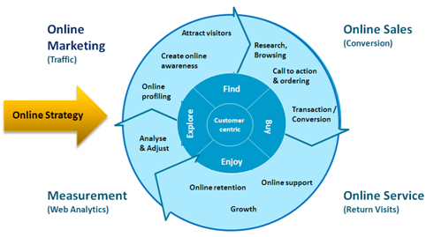
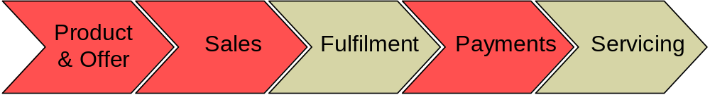
Example Value Chain Diagrams

Slide 13
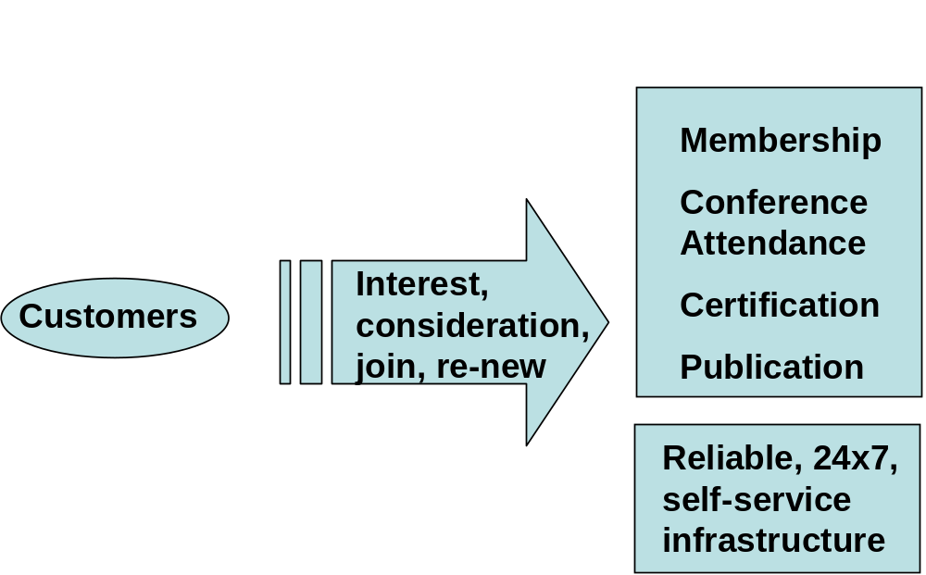
Example Solution Concept Diagram
A high-level representation of the solution envisaged
A pencil sketch of the expected solution at the outset of the engagement
Notes:
A Solution Concept diagram provides a high-level orientation of the solution that is envisaged in order to meet the objectives of the architecture engagement. In contrast to the more formal and detailed architecture diagrams developed in the following phases, the solution concept represents a "pencil sketch" of the expected solution at the outset of the engagement.
This diagram may embody key objectives, requirements, and constraints for the engagement and also highlight work areas to be investigated in more detail with formal architecture modeling.
The purpose of this diagram is to quickly on-board and align stakeholders for a particular change initiative, so that all participants understand what the architecture engagement is seeking to achieve and how it is expected that a particular solution approach will meet the needs of the enterprise.

Slide 14
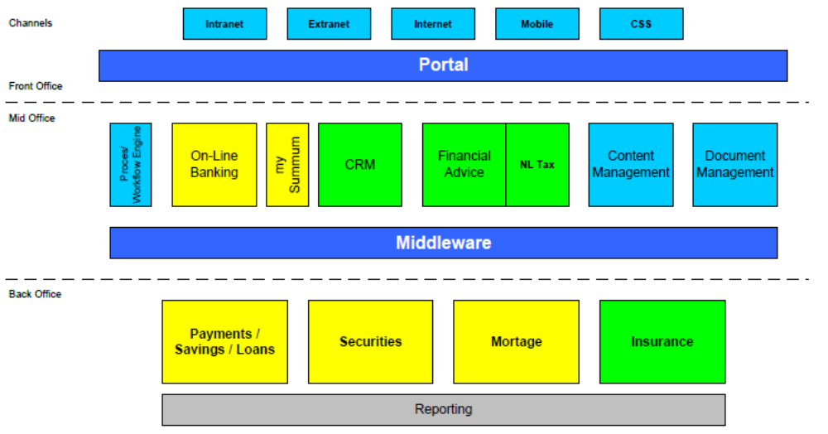
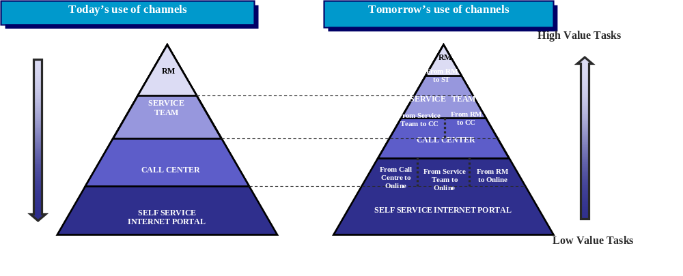
Example Solution Concept Diagrams

Slide 15
Phase C
Phase B: Business Architecture – Catalogs, Matrices and Diagrams
TOGAF is a registered trademark of The Open Group in the United States and other countries
Notes:
See section 2.3.4.2 of the Pocket Guide and Chapter 11 of TOGAF.
The block diagram shows we are on Application Architecture, one of the four major types of architecture addressed by TOGAF (the colours chosen match those of the metamodel)

Slide 16
Catalogs, Matrices and Diagrams
B
Catalogs
Organization/Actor catalog
Driver/Goal/Objective catalog
Role catalog
Business Service/Function catalog
Location catalog
Process/Event/Control/Product catalog
Contract/Measure catalog
Matrices
Business Interaction matrix
Actor/Role matrix
Diagrams
Business Footprint diagram
Business Service/Information diagram
Functional Decomposition diagram
Product Lifecycle diagram
Goal/Objective/Service diagram
Use-Case diagram
Organization Decomposition diagram
Process Flow diagram
Event diagram
Notes:
Catalogs capture inventories of the core assets of the Business. Catalogs are hierarchical in nature and capture the decomposition of a metamodel entity and also decompositions across related metamodel entities (e.g. organization → actor).
Catalogs form the raw material for development of matrices and diagrams and also act as a key resource for portfolio managing business and IT capability.
The Catalogs listed above are identified as being core to the definition of a Business Architecture
The structure of catalogs is based on the attributes of the contained metamodel entities as defined in Part IV.
Outcome:
Business Architecture Catalogs (a component of the Architecture Report)

Slide 17
Catalogs
Catalog | Purpose
Organization/ Actor Catalog | A definitive listing of all participants that interact with IT, including users and owners of IT systems. It contains the following metamodel entities: Organization Unit, Actor Location (may be included in this catalog if an independent Location catalog is not maintained)
Driver/Goal/ Objective Catalog | A cross-organizational reference of how an organization meets its drivers in practical terms through goals, objectives, and (optionally) measures. It contains the following metamodel entities: Organization Unit, Driver, Goal, Objective, Measure (may optionally be included)
Role Catalog | The purpose of the Role catalog is to provide a listing of all authorization levels or zones within an enterprise. Frequently, application security or behavior is defined against locally understood concepts of authorization that create complex and unexpected consequences when combined on the user desktop. It contains the following metamodel entities: Role
Notes:
Organization/Actor Catalog
The Organization/Actor catalog can be referenced when developing requirements in order to test for completeness.
Driver/Goal/Objectives catalog
Publishing a definitive breakdown of drivers, goals, and objectives allows change initiatives within the enterprise to identify synergies across the organization (e.g., multiple organizations attempting to achieve similar objectives), which in turn allow stakeholders to be identified and related change initiatives to be aligned or consolidated.
Role Catalog
If roles are defined, understood, and aligned across organizations and applications, this allows for a more seamless user experience and generally more secure applications, as administrators do not need to resort to workarounds in order to enable users to carry out their jobs.
In addition to supporting security definition for the enterprise, the Role catalog also forms a key input to identifying organizational change management impacts, defining job functions, and executing end-user training.
As each role implies access to a number of business functions, if any of these business functions are impacted, then change management will be required, organizational responsibilities may need to be redefined, and retraining may be needed.

Slide 18
Catalogs
Catalog | Purpose
Business Service / Function Catalog | A functional decomposition in a form that can be filtered, reported on, and queried, as a supplement to graphical Functional Decomposition diagrams. It contains the following metamodel entities: Organization Unit,Business Function, Business Service, Information System Service (may optionally be included here)
Location Catalog | A listing of all locations where an enterprise carries out business operations or houses architecturally relevant assets, such as data centers or end-user computing equipment. It contains the following metamodel entities: Location
Process/ Event/ Control/ Product Catalog | The Process/Event/Control/Product catalog provides a hierarchy of processes, events that trigger processes, outputs from processes, and controls applied to the execution of processes. This catalog provides a supplement to any Process Flow diagrams that are created and allows an enterprise to filter, report, and query across organizations and processes to identify scope, commonality, or impact. It contains the following metamodel entities: Process, Event, Control, Product
Notes:
Business Service/Function Catalog
The Business Service/Function catalog can be used to identify capabilities of an organization and to understand the level that governance is applied to the functions of an organization. This functional decomposition can be used to identify new capabilities required to support business change or may be used to determine the scope of change initiatives, applications, or technology components.
The Business Service/Function catalog contains the following metamodel entities:
Location Catalog
Maintaining a definitive list of locations allows change initiatives to quickly define a location scope and to test for completeness when assessing current landscapes or proposed target solutions. For example, a project to upgrade desktop operating systems will need to identify all locations where desktop operating systems are deployed.
Similarly, when new systems are being implemented, a diagram of locations is essential in order to develop appropriate deployment strategies that comprehend both user and application location and identify location-related issues, such as internationalization, localization, timezone impacts on availability, distance impacts on latency, network impacts on bandwidth, and access.
Process/Event/Control/Product Catalog
For example, the Process/Event/Control/Product catalog allows an enterprise to see relationships of processes to sub-processes in order to identify the full chain of impacts resulting from changing a high-level process.

Slide 19
Catalogs
Catalog | Purpose
Contract/ Measure Catalog | A listing of all agreed service contracts and (optionally) the measures attached to those contracts. It forms the master list of service levels agreed to across the enterprise. It contains the following metamodel entities: Business Service Information System Service (optionally) Contract Measure
Notes:
Contract/Measure Catalog
The Contract/Measure catalog provides a listing of all agreed service contracts and (optionally) the measures attached to those contracts. It forms the master list of service levels agreed to across the enterprise.
The Contract/Measure catalog contains the following metamodel entities:
Business Service
Information System Service (optionally)
Contract
Measure

Slide 20
Matrices
Business Interaction matrix
Actor/Role matrix
Notes:
Matrices show the core relationships between related metamodel entities.
Matrices form the raw material for development of diagrams and also act as a key resource for impact assessment
Diagrams present the Business Architecture information from a set of different perspectives (viewpoints) according to the requirements of the stakeholders.
Examples of both matrices and diagrams follow

Slide 21
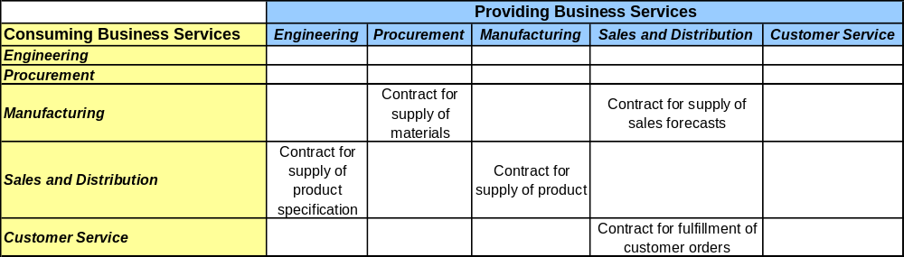
Business Interaction Matrix
The purpose of this matrix is to depict the relationship interactions between organizations and business functions across the enterprise.
Notes:
The purpose of this matrix is to depict the relationship interactions between organizations and business functions across the enterprise.
Understanding business interaction of an enterprise is important as it helps to highlight value chain and dependencies across organizations.
The Business Interaction matrix shows the following metamodel entities and relationships:
Organization
Business Function
Business Service
Business Service communicates with Business Service relationships
Business Service is dependent on Business Service relationships

Slide 22
Actor/role Matrix
This matrix show which actors perform which roles, supporting definition of security and skills requirements.
Office of
Steering Group
Business Unit
Strategy and Architecture
Infrastructure
CIO Actors
Actors
Actors
Actors
Implementation
Actors
Business Unit Application Architect
Enterprise Infrastructure Architect
Infrastructure Solution Architect
Head of Strategy and Architecture
Architecture Configuration Mgr
Enterprise Design Authority
Business Unit Service Owner
External Vendors / Suppliers
Technical Design Authority
Infrastructure Strategist
Head of Implementation
R = Responsible for carrying out the role
Enterprise Architect
IT Management Forum
Infrastructure Designer
Business Unit Head
Project Manager
A = Accountable for actors carrying out the role
IT Operations
C = Consulted in carrying out the role
CIO
I = Informed in carrying out the role
Strategy Lifecycle Roles
Architecture Refresh
I
R
A
I
C
C
R
C
C
C
I
I
R
I
C
C
Architecture Roadmap
I
C
A
I
R
C
C
I
C
R
I
I
R
C
C
I
C
Benefits Assessment
I
I
I
I
I
I
I
I
I
R
R
I
C
A
Change Management
C
I
A
I
I
I
R
I
I
I
R
R
C
Framework Refresh
C
C
C
C
C
I
C
A
I
I
I
R
C
C
I
Project Lifecycle Roles
Solution Architecture Vision
I
I
I
A
I
I
C
C
I
I
R
I
C
C
R
Logical Solution Architecture
A
I
I
C
C
I
I
R
I
C
C
C
R
Physical Solution Architecture
A
I
I
C
C
I
I
R
I
C
R
C
R
Design Governance
A
I
I
C
C
I
I
R
I
C
R
C
C
Architecture Configuration Management
C
I
I
R
R
R
A
Notes:
Understanding Actor-to-Role relationships is a key supporting tool in definition of training needs, user security settings, and organizational change management.
The Actor/Role matrix shows the following metamodel entities and relationships:
Actor
Role
Actor performs Role relationships

Slide 23
Diagrams
Business Footprint diagram
Business Service/Information diagram
Functional Decomposition diagram
Product Lifecycle diagram
Goal/Objective/Service diagram
Use-Case diagram
Organization Decomposition diagram
Process Flow diagram
Event diagram
Notes:
Matrices show the core relationships between related metamodel entities.
Matrices form the raw material for development of diagrams and also act as a key resource for impact assessment
Diagrams present the Business Architecture information from a set of different perspectives (viewpoints) according to the requirements of the stakeholders.
Examples of both matrices and diagrams follow

Slide 24
Business Footprint Diagram
Describes the links between business goals, organizational units, business functions, and services, and maps these functions to the technical components delivering the required capability.
Demonstrates only the key facts linking organization unit functions to delivery services and is utilized as a communication platform for senior-level (CxO) stakeholders
Notes:
A Business Footprint diagram describes the links between business goals, organizational units, business functions, and services, and maps these functions to the technical components delivering the required capability.
A Business Footprint diagram provides a clear traceability between a technical component and the business goal that it satisfies, whilst also demonstrating ownership of the services identified.
A Business Footprint diagram demonstrates only the key facts linking organization unit functions to delivery services and is utilized as a communication platform for senior-level (CxO) stakeholders
POSSIBLE VARIANTS
ADDITIONAL FUNCTIONAL DECOMPOSITION, SPREADING FUNCTIONALITY ACROSS LOWER LEVEL FUNCTIONS OWNED BY ALTERNATE ORGANIZATIONAL UNITS
IDENTIFICATION OF SERVICES PROVIDED OUTSIDE OF APPLICATION COMPONENTS DEFINED WITHIN NEWLEAF PARADIGM (I.E. NON-PACKAGE DELIVERED)
ADDITION OF PROCESS FLOW AS INTERMEDIATE STEP BETWEEN FUNCTIONS AND SERVICES
ADDITION OF REQUIREMENTS BETWEEN DRIVERS AND FUNCTIONS

Slide 25
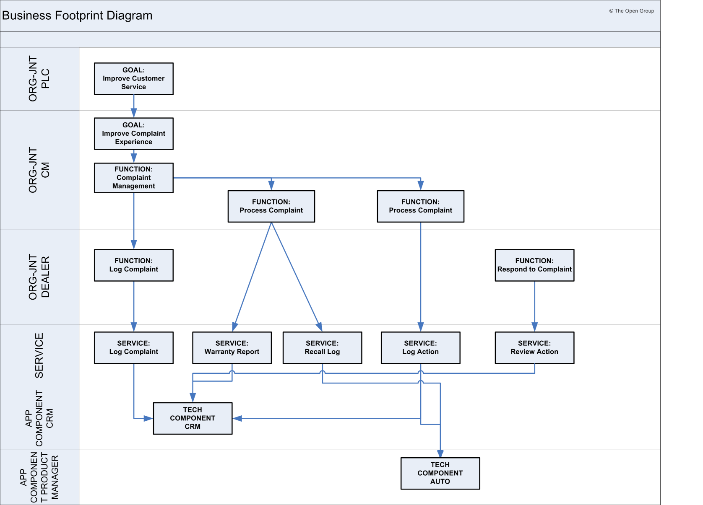
Example Business Footprint Diagram
Notes:
A Business Footprint diagram describes the links between business goals, organizational units, business functions, and services, and maps these functions to the technical components delivering the required capability.
A Business Footprint diagram provides a clear traceability between a technical component and the business goal that it satisfies, whilst also demonstrating ownership of the services identified.
A Business Footprint diagram demonstrates only the key facts linking organization unit functions to delivery services and is utilized as a communication platform for senior-level (CxO) stakeholders
POSSIBLE VARIANTS
ADDITIONAL FUNCTIONAL DECOMPOSITION, SPREADING FUNCTIONALITY ACROSS LOWER LEVEL FUNCTIONS OWNED BY ALTERNATE ORGANIZATIONAL UNITS
IDENTIFICATION OF SERVICES PROVIDED OUTSIDE OF APPLICATION COMPONENTS DEFINED WITHIN NEWLEAF PARADIGM (I.E. NON-PACKAGE DELIVERED)
ADDITION OF PROCESS FLOW AS INTERMEDIATE STEP BETWEEN FUNCTIONS AND SERVICES
ADDITION OF REQUIREMENTS BETWEEN DRIVERS AND FUNCTIONS

Slide 26
Business Service/Information Diagram
Shows the information needed to support one or more business services.
Shows what data is consumed by or produced by a business service and may also show the source of information.
Shows an initial representation of the information present within the architecture and therefore forms a basis for elaboration and refinement within Phase C (Data Architecture).
Notes:
The Business Service/Information diagram shows the information needed to support one or more business services. The Business Service/Information diagram shows what data is consumed by or produced by a business service and may also show the source of information.
The Business Service/Information diagram shows an initial representation of the information present within the architecture and therefore forms a basis for elaboration and refinement within Phase C (Data Architecture).
POSSIBLE VARIANTS
Basic Business Information - shows a single Service, with data consumed and data provided
Business Information featuring service interaction – shows multiple Services, capturing the chains of information consumer/provider relationships
Business Information featuring actor interaction – shows multiple Services and Actors, tracing information to external consumers and providers

Slide 27
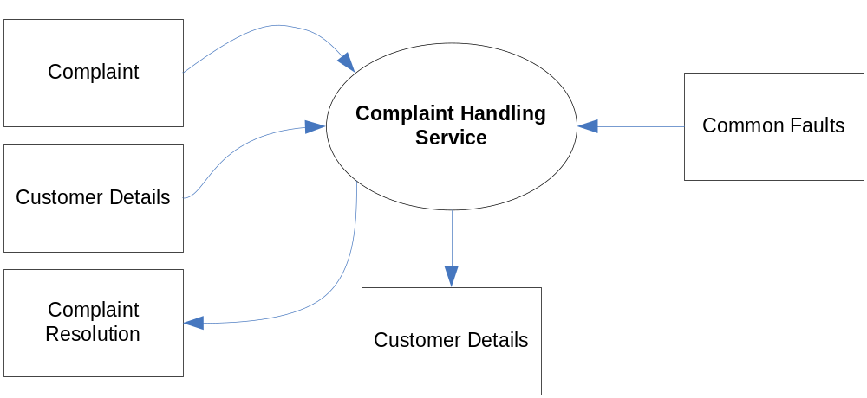
Example Business Service/Information Diagram
Basic example
Notes:
The Business Service/Information diagram shows the information needed to support one or more business services. The Business Service/Information diagram shows what data is consumed by or produced by a business service and may also show the source of information.
The Business Service/Information diagram shows an initial representation of the information present within the architecture and therefore forms a basis for elaboration and refinement within Phase C (Data Architecture).
POSSIBLE VARIANTS
Basic Business Information - shows a single Service, with data consumed and data provided
Business Information featuring service interaction – shows multiple Services, capturing the chains of information consumer/provider relationships
Business Information featuring actor interaction – shows multiple Services and Actors, tracing information to external consumers and providers

Slide 28
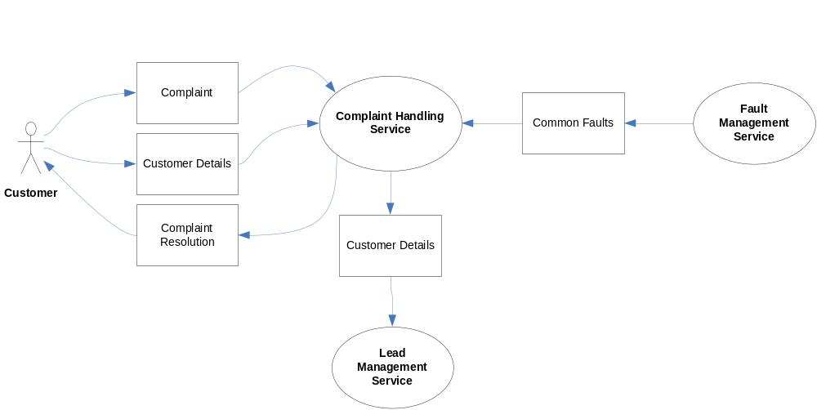
Example Business Service/Information Diagram
Extended example showing actors and service interactions

Slide 29
Functional Decomposition Diagram
It shows on a single page the capabilities of an organization that are relevant to the consideration of an architecture.
By examining the capabilities of an organization from a functional perspective, it is possible to quickly develop models of what the organization does without being dragged into extended debate on how the organization does it.
Notes:
The purpose of the Functional Decomposition diagram is to show on a single page the capabilities of an organization that are relevant to the consideration of an architecture. By examining the capabilities of an organization from a functional perspective, it is possible to quickly develop models of what the organization does without being dragged into extended debate on how the organization does it.
Once a basic Functional Decomposition diagram has been developed, it becomes possible to layer heat-maps on top of this diagram to show scope and decisions. For example, the capabilities to be implemented in different phases of a change program.

Slide 30
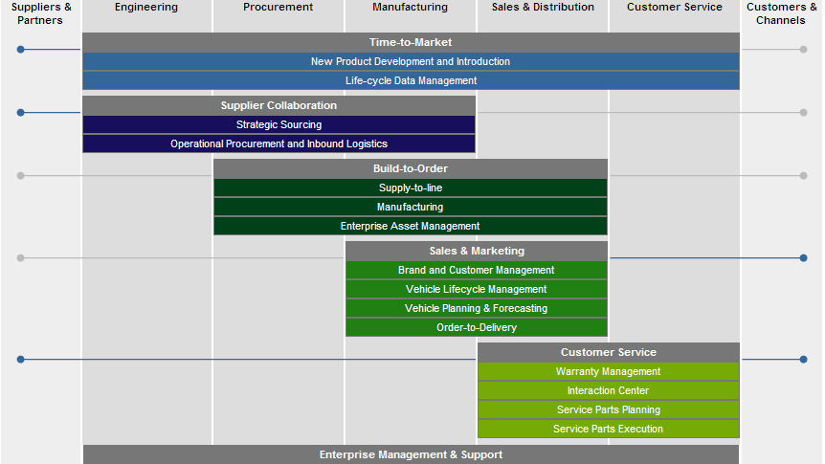
Example Functional Decomposition Diagram
Notes:
The purpose of the Functional Decomposition diagram is to show on a single page the capabilities of an organization that are relevant to the consideration of an architecture. By examining the capabilities of an organization from a functional perspective, it is possible to quickly develop models of what the organization does without being dragged into extended debate on how the organization does it.
Once a basic Functional Decomposition diagram has been developed, it becomes possible to layer heat-maps on top of this diagram to show scope and decisions. For example, the capabilities to be implemented in different phases of a change program.

Slide 31
Product Lifecycle Diagram
This assists in understanding the lifecycles of key entities within the enterprise.
Understanding product lifecycles is becoming increasingly important with respect to environmental concerns, legislation, and regulation where products must be tracked from manufacture to disposal.
Equally, organizations that create products that involve personal or sensitive information must have a detailed understanding of the product lifecycle during the development of Business Architecture in order to ensure rigor in design of controls, processes, and procedures. Examples of this include credit cards, debit cards, store/loyalty cards, smart cards, user identity credentials (identity cards, passports, etc.).
Notes:
Source: Kotler and Armstrong , 2004, Principles of Marketing , 10th Edition
The purpose of the Product Lifecycle diagram is to assist in understanding the lifecycles of key entities within the enterprise. Understanding product lifecycles is becoming increasingly important with respect to environmental concerns, legislation, and regulation where products must be tracked from manufacture to disposal. Equally, organizations that create products that involve personal or sensitive information must have a detailed understanding of the product lifecycle during the development of Business Architecture in order to ensure rigor in design of controls, processes, and procedures. Examples of this would include credit cards, debit cards, store/loyalty cards, smart cards, user identity credentials (identity cards, passports, etc.).

Slide 32
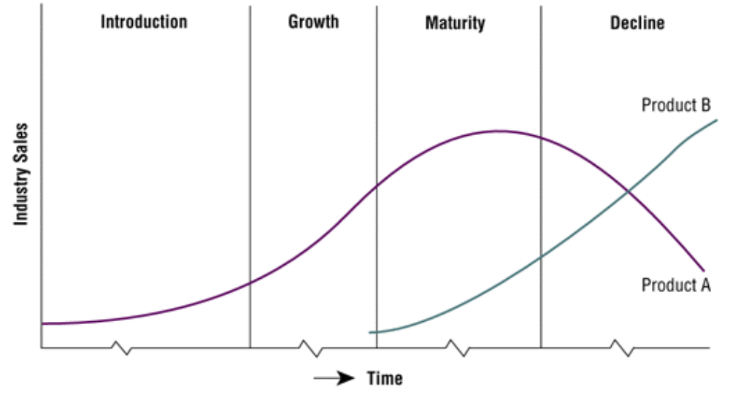
Example Product Lifecycle Diagram
Notes:
The purpose of the Product Lifecycle diagram is to assist in understanding the lifecycles of key entities within the enterprise. Understanding product lifecycles is becoming increasingly important with respect to environmental concerns, legislation, and regulation where products must be tracked from manufacture to disposal. Equally, organizations that create products that involve personal or sensitive information must have a detailed understanding of the product lifecycle during the development of Business Architecture in order to ensure rigor in design of controls, processes, and procedures. Examples of this would include credit cards, debit cards, store/loyalty cards, smart cards, user identity credentials (identity cards, passports, etc.).

Slide 33
Goal/Objective/Service Diagram
This defines the ways in which a service contributes to the achievement of a business vision or strategy.
Services are associated with the drivers, goals, objectives, and measures that they support, allowing the enterprise to understand which services contribute to similar aspects of business performance.
This also provides qualitative input on what constitutes high performance for a particular service.
Notes:
The purpose of a Goal/Objective/Service diagram is to define the ways in which a service contributes to the achievement of a business vision or strategy.
Services are associated with the drivers, goals, objectives, and measures that they support, allowing the enterprise to understand which services contribute to similar aspects of business performance. The Goal/Objective/Service diagram also provides qualitative input on what constitutes high performance for a particular service.
POSSIBLE VARIANTS
INCLUDE BUSINESS SERVICES AND LOCATIONS IN THIS VIEW LINK THEM TO THE LOCATIONS.

Slide 34
Example Goal/Objective/Service Diagram
Goal:Increase
Revenues
Role:CFO
Role:
VP Marketing
Role:
VP Sales
Objective:
After Sales
Market
Objective:
Creating new line
of cars by end of…
Function: Sales and Marketing
Service:
Marketing
Service: Pre-
owned vehicles-
Service:
Campaign
Service:
Sales
Service:
Pre-Sales
Service: Order
To Delivery
Notes:
The purpose of a Goal/Objective/Service diagram is to define the ways in which a service contributes to the achievement of a business vision or strategy.
Services are associated with the drivers, goals, objectives, and measures that they support, allowing the enterprise to understand which services contribute to similar aspects of business performance. The Goal/Objective/Service diagram also provides qualitative input on what constitutes high performance for a particular service.
POSSIBLE VARIANTS
INCLUDE BUSINESS SERVICES AND LOCATIONS IN THIS VIEW LINK THEM TO THE LOCATIONS.

Slide 35
Business Use-case Diagram
This displays the relationships between consumers and providers of business services.
Business services are consumed by actors or other business services and the Business Use-Case diagram provides added richness in describing business capability by illustrating how and when that capability is used.
They help to describe and validate the interaction between actors and their roles to processes and functions.
As the architecture progresses, the use-case can evolve from the business level to include data, application, and technology details. Architectural business use-cases can also be re-used in systems design work.
Notes:
A Business Use-Case diagram displays the relationships between consumers and providers of business services. Business services are consumed by actors or other business services and the Business Use-Case diagram provides added richness in describing business capability by illustrating how and when that capability is used.
The purpose of the Business Use-Case diagram is to help to describe and validate the interaction between actors and their roles to processes and functions. As the architecture progresses, the use-case can evolve from the business level to include data, application, and technology details. Architectural business use-cases can also be re-used in systems design work.
Use Case as expressed in a diagram
Common practice is to describe use cases in clear simple language and depict them in a diagram using the Unified Modeling Language (UML)

Slide 36
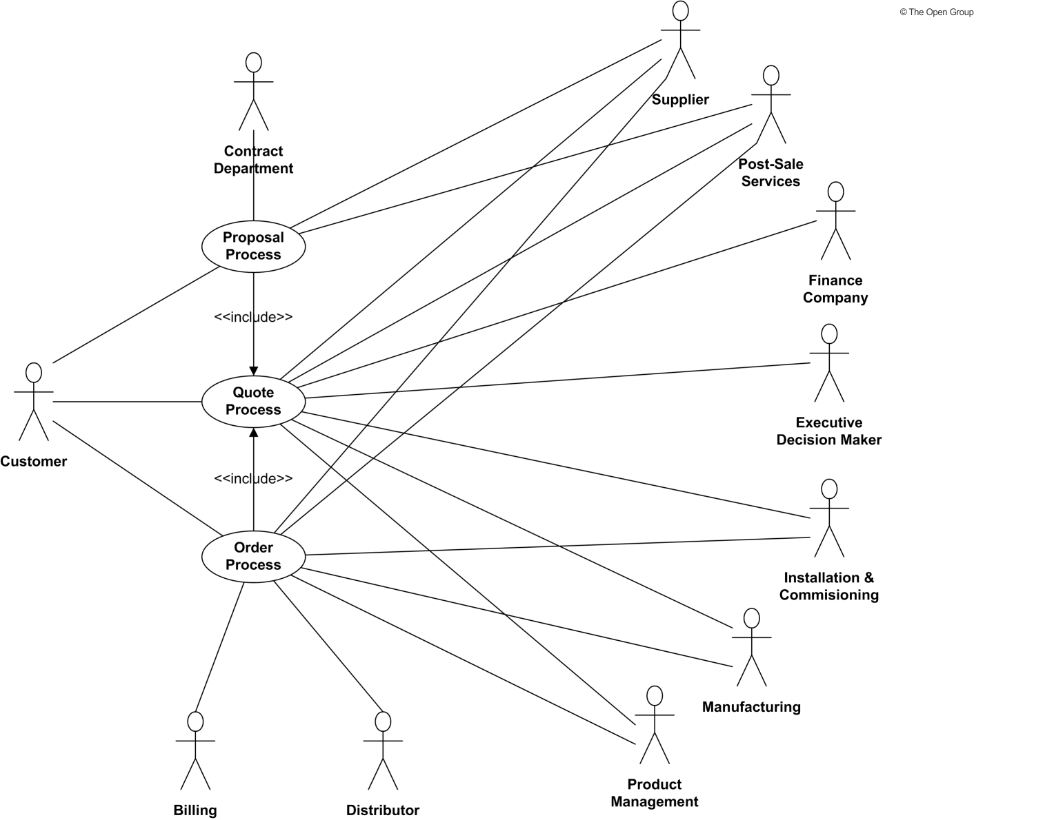
Example Business Use-case Diagram
Notes:
A Business Use-Case diagram displays the relationships between consumers and providers of business services. Business services are consumed by actors or other business services and the Business Use-Case diagram provides added richness in describing business capability by illustrating how and when that capability is used.
The purpose of the Business Use-Case diagram is to help to describe and validate the interaction between actors and their roles to processes and functions. As the architecture progresses, the use-case can evolve from the business level to include data, application, and technology details. Architectural business use-cases can also be re-used in systems design work.
Use Case as expressed in a diagram
Common practice is to describe use cases in clear simple language and depict them in a diagram using the Unified Modeling Language (UML)

Slide 37
Organization Decomposition Diagram
This describes the links between actor, roles, and location within an organization tree.
An organization map should provide a chain of command of owners and decision-makers in the organization.
Notes:
An Organization Decomposition diagram describes the links between actor, roles, and location within an organization tree.
An organization map should provide a chain of command of owners and decision-makers in the organization. Although it is not the intent of the Organization Decomposition diagram to link goal to organization, it should be possible to intuitively link the goals to the stakeholders from the Organization Decomposition diagram.
POSSIBLE VARIANTS
INCLUDE BUSINESS SERVICES IN THIS VIEW LINK THEM TO THE ACTORS AND/OR ROLES

Slide 38
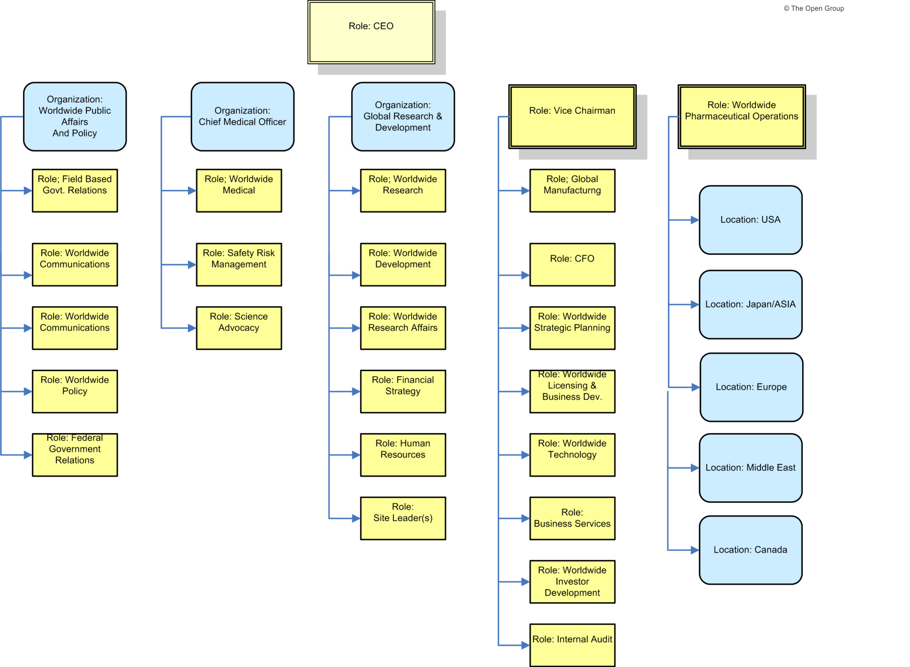
Example Organization Decomposition Diagram
Notes:
An Organization Decomposition diagram describes the links between actor, roles, and location within an organization tree.
An organization map should provide a chain of command of owners and decision-makers in the organization. Although it is not the intent of the Organization Decomposition diagram to link goal to organization, it should be possible to intuitively link the goals to the stakeholders from the Organization Decomposition diagram.
POSSIBLE VARIANTS
INCLUDE BUSINESS SERVICES IN THIS VIEW LINK THEM TO THE ACTORS AND/OR ROLES

Slide 39
Process Flow Diagram
This depicts all models and mappings related to the process metamodel entity.
It shows sequential flow of control between activities and may utilize swim-lane techniques to represent ownership and realization of process steps.
In addition to showing a sequence of activity, process flows can also be used to detail the controls that apply to a process, the events that trigger or result from completion of a process, and also the products that are generated from process execution.
Notes:
The purpose of the Process Flow diagram is to depict all models and mappings related to the process metamodel entity.
Process Flow diagrams show sequential flow of control between activities and may utilize swim-lane techniques to represent ownership and realization of process steps. For example, the application that supports a process step may be shown as a swim-lane.
In addition to showing a sequence of activity, process flows can also be used to detail the controls that apply to a process, the events that trigger or result from completion of a process, and also the products that are generated from process execution.
Process Flow diagrams are useful in elaborating the architecture with subject specialists, as they allow the specialist to describe "how the job is done" for a particular function. Through this process, each process step can become a more fine-grained function and can then in turn be elaborated as a process.

Slide 40
Example Process Flow Diagram
Start
Step 1
Step 2
Step 3
Step 4
Step 5
Step 6
Step 6
Step 6
STOP
Notes:
The purpose of the Process Flow diagram is to depict all models and mappings related to the process metamodel entity.
Process Flow diagrams show sequential flow of control between activities and may utilize swim-lane techniques to represent ownership and realization of process steps. For example, the application that supports a process step may be shown as a swim-lane.
In addition to showing a sequence of activity, process flows can also be used to detail the controls that apply to a process, the events that trigger or result from completion of a process, and also the products that are generated from process execution.
Process Flow diagrams are useful in elaborating the architecture with subject specialists, as they allow the specialist to describe "how the job is done" for a particular function. Through this process, each process step can become a more fine-grained function and can then in turn be elaborated as a process.

Slide 41
Example Process Flow Diagram
Technical Support
Team
Sales Rep
Pricer
Pricer
Start
Step 1
Step 2
Step 3
Step 4
Custom app
Email
CRM
MS Word
MS Excel
Custom Bid Approver
Customer Rep
Customer Rep
Customer Rep
Step 5
Step 6
Step 6
Step 6
STOP
IWF
email
Consolidation
Tool
Spreadsheet
Process Flow (w/Roles & Applications)

Slide 42
Events Diagram
This depicts the relationship between events and process.
Certain events - such as arrival of information (e.g. a customer’s sales order) or a point in time (e.g. end of fiscal quarter) cause work and actions to be undertaken within the business.
Notes:
The purpose of the Event diagram is to depict the relationship between events and process.
Certain events - such as arrival of certain information (e.g., customer submits sales order) or a certain point in time (e.g., end of fiscal quarter) - cause work and certain actions need to be undertaken within the business. These are often referred to as "business events" or simply "events" and are considered as triggers for a process. It is important to note that the event has to trigger a process and generate a business response or result.

Slide 43
Example Events Diagram
Event
Process
Impacts/Generates
Business result
Triggers
(e.g. End of Fiscal Quarter)
(e.g. Financial Reporting Process)
(e.g. 1Q results reported to Government Agencies)
Notes:
The purpose of the Event diagram is to depict the relationship between events and process.
Certain events - such as arrival of certain information (e.g., customer submits sales order) or a certain point in time (e.g., end of fiscal quarter) - cause work and certain actions need to be undertaken within the business. These are often referred to as "business events" or simply "events" and are considered as triggers for a process. It is important to note that the event has to trigger a process and generate a business response or result.

Slide 44
Example Events Matrix
EVENT | PROCESS TRIGGERED | BUSINESS RESULT(S)
Customer submits sales order | Sales order processing Create & save sales order Generate acknowledgement Confirm receipt of customer order Begin order fulfillment activities | Sales order captured in order book
Customer submits request for custom product | Custom product configuration Capture requirements from customer Define custom specifications Price custom configuration Negotiate with customer Secure approval from customer regarding configuration and price | Custom product configured Customer contract signed
End of quarter | Financial reporting process | Financial report generated
Notes:
The event/process relationship can also be documented in a table format where the business events are listed.

Slide 45
Phase C
Phase C: Data Architecture – Catalogs, Matrices and Diagrams
TOGAF is a registered trademark of The Open Group in the United States and other countries
Notes:
See section 2.3.4.2 of the Pocket Guide and Chapter 11 of TOGAF.
The block diagram shows we are on Application Architecture, one of the four major types of architecture addressed by TOGAF (the colours chosen match those of the metamodel)

Slide 46
Catalogs, Matrices and Diagrams
C
Catalogs
Data Entity/Data Component catalog
Matrices
Data Entity/Business Function matrix
System/Data matrix
Diagrams
Class diagram
Data Dissemination diagram
Data Security diagram
Class Hierarchy diagram
Data Migration diagram
Data Lifecycle diagram

Slide 47
Catalogs
Catalog | Purpose
Data Entity/Data Component Catalog | To identify and maintain a list of all the data use across the enterprise, including data entities and also the data components where data entities are stored. It contains the following metamodel entities: Data Entity Logical Data Component Physical Data Component
Notes:
An agreed Data Entity/Data Component catalog supports the definition and application of information management and data governance policies and also encourages effective data sharing and re-use.

Slide 48
Matrices
Data Entity/Business Function matrix
Application/Data matrix
Notes:
System/Data matrix -> Application/Data Matrix for TOGAF 9.1

Slide 49
Data Entity/Business Function Matrix
The purpose of the Data Entity/Business Function matrix is to depict the relationship between data entities and business functions within the enterprise.
The mapping of the Data Entity-Business Function relationship enables the following to take place:
  Assignment of ownership of data entities to organizations
  Understand the data and information exchange requirements business services
  Support the gap analysis and determine whether any data entities are missing and need to be created
  Define system of origin, system of record, and system of reference for data entities
  Enable development of data governance programs across the enterprise (establish data steward, develop data standards pertinent to the business function, etc.)
Notes:
The purpose of the Data Entity/Business Function matrix is to depict the relationship between data entities and business functions within the enterprise.
The mapping of the Data Entity-Business Function relationship enables the following to take place:
Assign ownership of data entities to organizations
Understand the data and information exchange requirements business services
Support the gap analysis and determine whether any data entities are missing and need to be created
Define system of origin, system of record, and system of reference for data entities
Enable development of data governance programs across the enterprise (establish data steward, develop data standards pertinent to the business function, etc.)
An example of the relationship matrix is provided . Include the business functions on y-axis and data entities on the x axis. The intersection of the rows and columns can contain attributes like business service, owner and whether the function creates, reads, updates or deletes the data entities.

Slide 50
Example Data Entity/Business Function Matrix
BUSINESS FUNCTION (Y-AXIS) / DATA ENTITY (X-AXIS) | CUSTOMER MASTER | BUSINESS PARTNER | CUSTOMER LEADS | PRODUCT MASTER
Customer Relationship Management | Business partner data management service Owner – Sales & Marketing business unit executive Function can Create, read, update and delete customer master data | Business partner data management service Owner of data entity (person or organization) Function can Create, read, update and delete | Lead Processing Service Owner – Customer Relationship Manager Function can only Create, read, update customer leads | N/A
Supply Chain Management | Customer Requirement Processing Service Owner – Supply Chain Manager | N/A | N/A | Product data management service Owner – Global product development organization
Notes:
The purpose of the Data Entity/Business Function matrix is to depict the relationship between data entities and business functions within the enterprise.
The mapping of the Data Entity-Business Function relationship enables the following to take place:
Assign ownership of data entities to organizations
Understand the data and information exchange requirements business services
Support the gap analysis and determine whether any data entities are missing and need to be created
Define system of origin, system of record, and system of reference for data entities
Enable development of data governance programs across the enterprise (establish data steward, develop data standards pertinent to the business function, etc.)
An example of the relationship matrix is provided . Include the business functions on y-axis and data entities on the x axis. The intersection of the rows and columns can contain attributes like business service, owner and whether the function creates, reads, updates or deletes the data entities.

Slide 51
Application/Data Matrix
The purpose of the Application/Data matrix is to depict the relationship between applications and the data entities that are accessed and updated by them.
Applications will create, read, update, and delete specific data entities that are associated with them.
  For example, a CRM application will create, read, update, and delete customer entity information.

Slide 52
Example Application/Data Matrix
APPLICATION (Y-AXIS) AND DATA (X-AXIS) | DESCRIPTION OR COMMENTS | DATA ENTITY | DATA ENTITY TYPE
CRM | System of record for customer master data | Customer data | Master data
Commerce Engine | System of record for order book | Sales orders | Transactional data
Sales Business Warehouse | Warehouse and data mart that supports North American region | Intersection of multiple data entities (e.g. All sales orders by customer XYZ and by month for 2006) | Historical data
Notes:
The System/Data matrix is a two-dimensional table with Logical Application Component on one axis and Data Entity on the other axis.
The data entities in a package/packaged services environment can be classified as master data, reference data, transactional data, content data, and historical data. Applications that operate on the data entities include transactional applications, information management applications, and business warehouse applications.
The mapping of the Application Component-Data Entity relationship is an important step as it enables the following to take place:
Assign access of data to specific applications in the organization
Understand the degree of data duplication within different applications, and the scale of the data lifecycle
Understand where the same data is updated by different applications
Support the gap analysis and determine whether any of the applications are missing and as a result need to be created

Slide 53
Diagrams
Conceptual Data diagram
Logical Data diagram
Data Dissemination diagram
Data Security diagram
Data Migration diagram
Data Lifecycle diagram

Slide 54
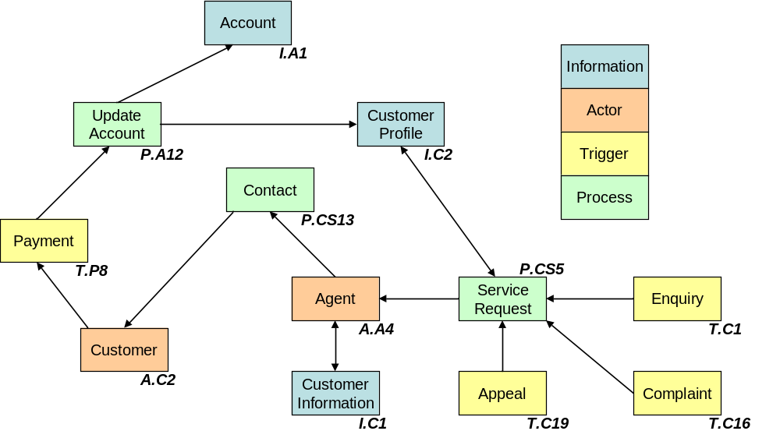
Conceptual Data Diagram
The purpose is to depict the relationships among the critical data entities (or classes) within the enterprise.
Notes:
The example is shown using a Simplified UML class diagram.
The key purpose of the Conceptual Data diagram is to depict the relationships among the critical data entities (or classes) within the enterprise. This diagram is developed to clearly present the relationships and to help understand the lower-level data models for the enterprise.

Slide 55
Logical Data Diagram
The purpose is to depict logical views relationships among the critical data entities (or classes) within the enterprise.
The audience is
  Application developers
  Database designers
Notes:
The Logical Data diagram is similar to the Conceptual Data Diagram but targets application developers and database designers.
The same techniques can be used as for the Conceptual Data diagram.

Slide 56
Data Dissemination Diagram
The purpose of the Data Dissemination diagram is to show the relationship between
  data entity
  business service
  application components
The diagram should show how the logical entities are to be physically realized by application components.
Additionally, the diagram may show data replication and system ownership of the master reference for data.

Slide 57
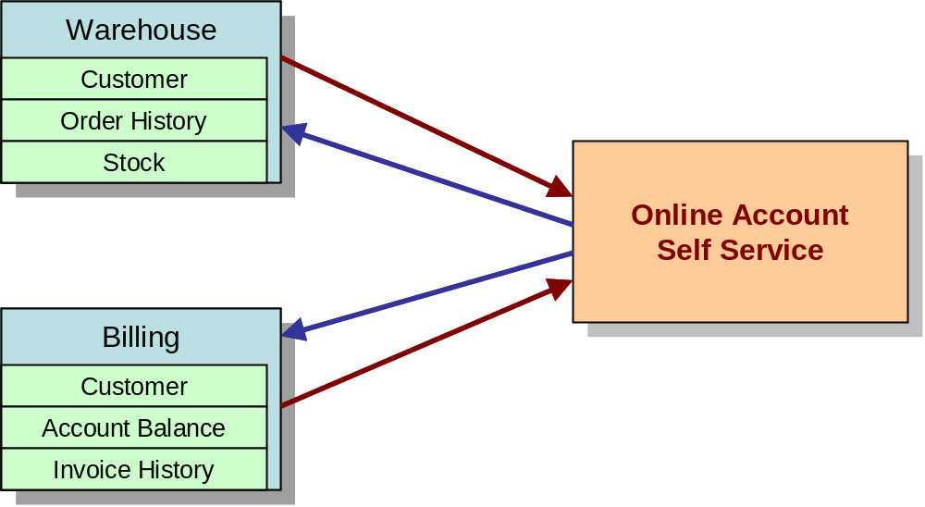
Example Data Dissemination Diagram
Business Service | Data Entities | Application
Online Account Self Service | Customer | Warehouse Billing
 | Order History | Warehouse
 | Stock | Warehouse
 | Account Balance | Billing
 | Invoice History | Billing
Notes:
The purpose of the Data Dissemination diagram is to show the relationship between data entity, business service, and application components. The diagram shows how the logical entities are to be physically realized by application components. This allows effective sizing to be carried out and the IT footprint to be refined. Moreover, by assigning business value to data, an indication of the business criticality of application components can be gained.
Additionally, the diagram may show data replication and system ownership of the master reference for data. In this instance, it can show two copies and the master-copy relationship between them. This diagram can include services; that is, services encapsulate data and they reside in an application, or services that reside on an application and access data encapsulated within the application.
This enables the following
Understanding of the Service boundaries a bit more clearly and assigning ownership of the service
Understanding of the business service to application component relationship at times will identify any legacy applications which may not be known within the enterprise due to poor or no documentation

Slide 58
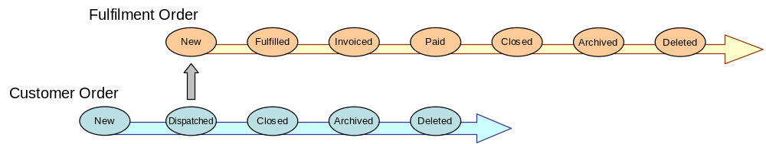
Data Lifecycle Diagram
The Data Lifecycle diagram is an essential part of managing business data throughout its lifecycle from conception until disposal within the constraints of the business process.
Notes:
The Data Lifecycle diagram is an essential part of managing business data throughout its lifecycle from conception until disposal within the constraints of the business process.
The data is considered as an entity in its own right, decoupled from business process and activity. Each change in state is represented on the diagram which may include the event or rules that trigger that change in state.
The separation of data from process allows common data requirements to be identified which enables resource sharing to be achieved more effectively. In the example above, it is clear that a common approach to data archiving can be adopted – within the constraints of business rules.

Slide 59
Data Security Diagram
The purpose of the Data Security diagram is to depict which actor (person, organization, or system) can access which enterprise data.
This relationship can also be shown in a matrix form between two objects or can be shown as a mapping.
Notes:
Data is considered as an asset to the enterprise and data security simply means ensuring that enterprise data is not compromised and that access to it is suitably controlled.
The diagram can also be used to demonstrate compliance with data privacy laws and other applicable regulations (HIPAA, SOX, etc). This diagram should also consider any trust implications where an enterprise's partners or other parties may have access to the company's systems, such as an outsourced situation where information may be managed by other people and may even be hosted in a different country.

Slide 60
Example Data Security Diagram
Class of Roles
(by job function)
Actor
Business
Process
Function
Single Sign
On or
Access Control
Physical
Access
-
Location
Business
Service
Access Control
(levels of
Granularity)
Access Control
(levels of
Granularity)
Logical
Application
Component
Notes:
The diagram approach

Slide 61
Example Data Security Matrix
ACTOR | CLASS OF ROLES (JOB FUNCTION) | FUNCTION | BUSINESS SERVICE | LOCATION | TYPE OF ACCESS
Financial Analyst | SOA Portfolio Financial Analyst | Financial Analysis | SOA portfolio service | NA (US, CA) EMEA (UK, DE) APJ | Physical Access Control (tables xyz only)
Procurement & Spend Analyst | Procurement Management and Control | WW Direct Procurement | Supplier portal Service | NA (US Midwest) | Access control
WW Contracts System (application) | Not applicable | WW Direct Procurement | Supplier Portal Service | LA | Access control (system to system)
WW Product Development (Org Unit) | Geo Brand Managers | WW Direct Procurement | Supplier Portal Service | WW (all Geos) | Access Control
Notes:
A matrix approach

Slide 62
Data Migration Diagram
The purpose of the Data Migration diagram is to show the flow of data from the source to the target applications.
The diagram will provide a visual representation of the spread of sources/targets and serve as a tool for data auditing and establishing traceability.
Notes:
Data migration is critical when implementing a package or packaged service-based solution. This is particularly true when an existing legacy application is replaced with a package or an enterprise is to be migrated to a larger packages/packaged services footprint. Packages tend to have their own data model and during data migration the legacy application data may need to be transformed prior to loading into the package.
Data migration activities will usually involve the following steps:
Extract data from source applications (baseline systems)
Profile source data
Perform data transformation operations, including data quality processes:
Standardize, normalize, de-duplicate source data (data cleansing)
Match, merge, and consolidate data from different source(s)
Source-to-target mappings
Load into target applications (target systems)

Slide 63
Example Data Migration Diagram
“Baseline” application components
Data migration technology components
“Target” application components
ABM
Source Staging
Transformation & Data Quality
Target Staging
CRM
Source of Customer records
CCB
System of Record for Customer Master
ERP
BDW
Source of order history
System of Record for Material Master & Order history
MRPA
Source of Material data
SRM
VLC (one per geo)
System of Record for Vendor Master & Contracts
Source of vendor data
Notes:
The purpose of the Data Migration diagram is to show the flow of data from the source to the target applications. The diagram will provide a visual representation of the spread of sources/targets and serve as a tool for data auditing and establishing traceability. This diagram can be elaborated or enhanced as detailed as necessary. For example, the diagram can contain just an overall layout of migration landscape or could go into individual application metadata element level of detail.

Slide 64
Example Data Migration Mapping
SOURCE LOGICAL APPLICATION COMPONENT | SOURCE DATA ELEMENT | TARGET LOGICAL APPLICATION COMPONENT | TARGET DATA ELEMENT
ABM | Cust_Name | CRM | CUSTNAME
 | Cust_Street_Addr |  | CUSTADDR_LINE1
 | Cust_Street_Addr |  | CUSTADDR_LINE2
 | Cust_Street_Addr |  | CUSTADDR_LINE3
 | Cust_ContactName |  | CUSTCONTACT
 | Cust_Tele |  | CUSTTELEPHONE
Notes:
A mapping table can be used in conjunction with the diagram to depict the relationship between source and target meta-data elements. In addition entity relationship diagrams can also be depicted to enhance this appropriately.

Slide 65
Phase C
Phase C: Application Architecture – Catalogs, Matrices and Diagrams
Application
Architecture
TOGAF is a registered trademark of The Open Group in the United States and other countries
Notes:
See section 2.3.4.2 of the Pocket Guide and Chapter 11 of TOGAF.
The block diagram shows we are on Application Architecture, one of the four major types of architecture addressed by TOGAF (the colours chosen match those of the metamodel)

Slide 66
Catalogs, Matrices and Diagrams
C
Catalogs
Application Portfolio catalog
Interface catalog
Matrices
Application/Organization matrix
Role/Application matrix
Application/Function matrix
Application Interaction matrix
Diagrams
Application Communication diagram
Application and User Location diagram
Application Use-Case diagram
Enterprise Manageability diagram
Process/Application Realization diagram
Software Engineering diagram
Application Migration diagram
Software Distribution diagram
Notes:
Another view on the Catalogs/Matrices and Diagrams for this Phase.
(Changes in TOGAF 9.1)
System/Organization matrix-> Application/Organization matrix
Role/System matrix->Role/Application matrix
System/Function matrix->Application/Function matrix
System Use-Case diagram->Application Use-Case diagram
Process/System Realization diagram -> Process/Application Realization diagram

Slide 67
Catalogs
Catalog | Purpose
Application Portfolio Catalog | To identify and maintain a list of all the applications in the enterprise. This list helps to define the horizontal scope of change initiatives that may impact particular kinds of applications. An agreed Application Portfolio allows a standard set of applications to be defined and governed. It contains the following metamodel entities: Information System Service Logical Application Component Physical Application Component
Interface Catalog | The purpose of the Interface catalog is to scope and document the interfaces between applications to enable the overall dependencies between applications to be scoped as early as possible. It contains the following metamodel entities: Logical Application Component Physical Application Component Application communicates with application relationship
Notes:
Application Portfolio Catalog
The Application Portfolio catalog provides a foundation on which to base the remaining matrices and diagrams. It is typically the start point of the Application Architecture phase.
Existing application registries and repositories - such as SAP's Solution Manager and System Landscape Directory products - also provide input into this catalog from a baseline and target perspective.
Interface Catalog
Systems will create, read, update, and delete data within other systems; this will be achieved by some kind of interface, whether via a batch file that is loaded periodically, a direct connection to another system's database, or via some form of API or web service.
The mapping of the Application Component-Application Component entity relationship is an important step as it enables the following to take place:
Understand the degree of interaction between applications, identifying those that are central in terms of their dependencies on other systems
Understand the number and types of interfaces between applications
Understand the degree of duplication of interfaces between applications
Identify the potential for simplification of interfaces when considering the target Application Portfolio
Support the gap analysis and determine whether any of the applications are missing and as a result need to be created

Slide 68
Matrices
Application/Organization matrix
Role/Application matrix
Application/Function matrix
Application Interaction matrix

Slide 69
Application/Organization Matrix
The purpose of this matrix is to depict the relationship between applications and organizational units within the enterprise.
The mapping of the Application Component-Organization Unit relationship is an important step as it enables the following to take place:
  Assign usage of applications to the organization units that perform business functions
  Understand the application support requirements of the business services and processes carried out by an organization unit
  Support the gap analysis and determine whether any of the applications are missing and as a result need to be created
  Define the application set used by a particular organization unit
Notes:
The purpose of this matrix is to depict the relationship between applications and organizational units within the enterprise.
Business functions are performed by organizational units. Some of the functions and services performed by those organizational units will be supported by applications. The mapping of the Application Component-Organization Unit relationship is an important step as it enables the following to take place:
Assign usage of applications to the organization units that perform business functions
Understand the application support requirements of the business services and processes carried out by an organization unit
Support the gap analysis and determine whether any of the applications are missing and as a result need to be created
Define the application set used by a particular organization unit

Slide 70
Example Application/Organization Matrix
APPLICATION (Y-AXIS) AND ORGANISATION UNIT (X-AXIS) | CUSTOMER SERVICES | PROCUREMENT AND WAREHOUSING | HR | CORPORATE FINANCE
SAP HR | X | X | X
SIEBEL | X | X
SAP FINANCIALS | X | X |  | X
PROCURESOFT | X | X
Notes:
The Application/Organization matrix is a two-dimensional table with Logical/Physical Application Component on one axis and Organization Unit on the other axis.
The relationship between these two entities is a composite of a number of metamodel relationships that need validating:
Organization Units own Services
Actors that belong to Organization Units use Services
Services are realized by Logical/Physical Application Components

Slide 71
Role/Application Matrix
The purpose of this matrix is to depict the relationship between applications and the business roles that use them within the enterprise.
The mapping of the Application Component-Role relationship is an important step as it enables the following to take place:
  Assign usage of applications to the specific roles in the organization
  Understand the application security requirements of the business services and processes supporting the function, and check these are in line with current policy
  Support the gap analysis and determine whether any of the applications are missing and as a result need to be created
  Define the application set used by a particular business role; essential in any move to role-based computing
Notes:
The purpose of the Role/Application matrix is to depict the relationship between applications and the business roles that use them within the enterprise.
People in an organization interact with applications. During this interaction, these people assume a specific role to perform a task; for example, product buyer.
The mapping of the Application Component-Role relationship is an important step as it enables the following to take place:
Assign usage of applications to the specific roles in the organization
Understand the application security requirements of the business services and processes supporting the function, and check these are in line with current policy
Support the gap analysis and determine whether any of the applications are missing and as a result need to be created
Define the application set used by a particular business role; essential in any move to role-based computing

Slide 72
Example Role/Application Matrix
APPLICATION (Y-AXIS) AND FUNCTION (X-AXIS) | CALL CENTRE OPERATOR | CALL CENTRE MANAGER | FINANCE ANALYST | CHIEF ACCOUNTANT
SAP HR | X | X | X | X
SIEBEL | X | X
SAP FINANCIALS | X | X | X | X
PROCURESOFT | X | X
Notes:
The Role/Application matrix is a two-dimensional table with Logical Application Component on one axis and Role on the other axis.
The relationship between these two entities is a composite of a number of metamodel relationships that need validating:
Role accesses Function
Function is bounded by Service
Services are realized by Logical/Physical Application Components

Slide 73
Application/Function Matrix
The purpose of this matrix is to depict the relationship between applications and business functions within the enterprise.
The mapping of the Application Component-Function relationship is an important step as it enables the following to take place:
  Assign usage of applications to the business functions that are supported by them
  Understand the application support requirements of the business services and processes carried out
  Support the gap analysis and determine whether any of the applications are missing and as a result need to be created
  Define the application set used by a particular business function
Notes:
The purpose of the Application/Function matrix is to depict the relationship between applications and business functions within the enterprise.
Business functions are performed by organizational units. Some of the business functions and services will be supported by applications. The mapping of the Application Component-Function relationship is an important step as it enables the following to take place:
Assign usage of applications to the business functions that are supported by them
Understand the application support requirements of the business services and processes carried out
Support the gap analysis and determine whether any of the applications are missing and as a result need to be created
Define the application set used by a particular business function

Slide 74
Example Application/Function Matrix
APPLICATION (Y-AXIS) AND FUNCTION (X-AXIS) | CALL CENTRE 1ST LINE | WAREHOUSE CONTROL | VACANCY FILLING | GENERAL LEDGER MAINTENANCE
SAP HR | X | X | X | X
SIEBEL | X | X
SAP FINANCIALS | X | X |  | X
PROCURESOFT | X | X
Notes:
The Application/Function matrix is a two-dimensional table with Logical Application Component on one axis and Function on the other axis.
The relationship between these two entities is a composite of a number of metamodel relationships that need validating:
Function is bounded by Service
Services are realized by Logical/Physical Application Components

Slide 75
Diagrams
Application Communication diagram
N2 model or Node Connectivity diagram
Application and User Location diagram
System Use-Case diagram
Enterprise Manageability diagram
Process/Application Realization diagram
Software Engineering diagram
Application Migration diagram
Software Distribution diagram
Notes:
These diagrams will be discussed in the slides that follow.

Slide 76
Application Communication Diagram
The purpose of this diagram is to depict all models and mappings related to communication between applications in the metamodel entity.
It shows application components and interfaces between components.
Communication should be logical and should only show intermediary technology where it is architecturally relevant.
Notes:
The purpose of the Application Communication diagram is to depict all models and mappings related to communication between applications in the metamodel entity.
It shows application components and interfaces between components.
Interfaces may be associated with data entities where appropriate.
Applications may be associated with business services where appropriate.
Communication should be logical and should only show intermediary technology where it is architecturally relevant.

Slide 77
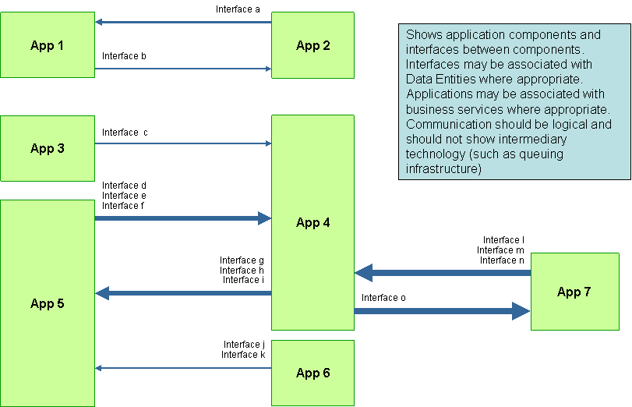
Application Communication Diagram
Notes:
The purpose of the Application Communication diagram is to depict all models and mappings related to communication between applications in the metamodel entity.
It shows application components and interfaces between components. Interfaces may be associated with data entities where appropriate. Applications may be associated with business services where appropriate. Communication should be logical and should only show intermediary technology where it is architecturally relevant.

Slide 78
N2 Model
ABC
1c
1a
ABM
1b
2a
3c
CCD
3a
CRM
4a
3b
1d
IPC
3d
4b
Notes:
An excellent model is provided in the Federal Enterprise Architecture Framework called the N2 model, or Node Connectivity diagram. The N2 model simply represents an alternative method to portray the connectivity between application components of an enterprise. The applications of the enterprise are shown as boxes on the diagonal of the chart. Information flow between the application components is captured as numbered intersections at the vertical and horizontal axes.
The chart is read in the clockwise direction. For example, the information flow from the ABC application to the ABM application is annotated at the intersection labeled 1a (above the diagonal). The other side of that interface—the flow of information from the ABM system to the ABC system—is annotated at the intersection labeled 1b (below the diagonal).
Continued on the next slide…

Slide 79
Information Exchange Matrix
LABEL | SOURCE | DESTINATION | DATA ENTITY | EVENT TRIGGERED
1a | ABC | ABM | Sales order (create request) | New sales order from front end
1b | ABM | ABC | Sales order (confirm create) | Order created in the backend ERP system
2a | ABM | CCD | Product catalog | Subscribe/ Publish timer
Notes:
The details or characteristics of each of these information flows are presented in the accompanying Information Exchange Matrix (IEM). Each numbered interface in the Node Connectivity N2 Chart becomes a row in the IEM. The information exchange is thoroughly described in the IEM example shown.

Slide 80
Application & User Location Diagram
The purpose of this diagram is to clearly depict the business locations from which business users typically interact with the applications, but also the hosting location of the application infrastructure.
The diagram enables:
  Identification of the number of package instances needed
  Estimation of the number and the type of user licenses
  Estimation of the level of support needed
  Selection of system management tools, structure, and management system
  Appropriate planning for the technological components of the business
  Performance considerations while implementing solutions
Notes:
The Application and User Location diagram shows the geographical distribution of applications. It can be used to show where applications are used by the end user; the distribution of where the host application is executed and/or delivered in thin client scenarios; the distribution of where applications are developed, tested, and released; etc.Analysis can reveal opportunities for rationalization, as well as duplication and/or gaps.
The purpose of this diagram is to clearly depict the business locations from which business users typically interact with the applications, but also the hosting location of the application infrastructure. The diagram enables:
Identification of the number of package instances needed to sufficiently support the user population that may be spread out geographically
Estimation of the number and the type of user licenses for the package or other software
Estimation of the level of support needed for the users and location of support center
Selection of system management tools, structure, and management system required to support the enterprise users/customers/partners both locally and remotely
Appropriate planning for the technological components of the business, namely server sizing and network bandwidth, etc.
Performance considerations while implementing application and technology architecture solutions

Slide 81
Example Application & User Location Diagram (part 1)
APPLICATION | USER TYPE | INTERNAL, CUSTOMER OR PARTNER | USER BUSINESS LOCATION | LOCATION ADDRESS | ORG UNIT (USER BELONGS TO)
CRM | Developer Super User Administrator | Internal | NA Western Region EMEA Headquarters, UK | Chicago Sears tower office Chicago Downtown office Middlesex, London | NA Sales & Marketing EMEA Sales
SAP R/3 | Test Engineers Mechanical Engineers Procurement managers | Internal | Beijing Manufacturing Plant |  | Manufacturing & logistics
Notes:
Part 1 is a matrix showing for each application, users by type, business and location

Slide 82
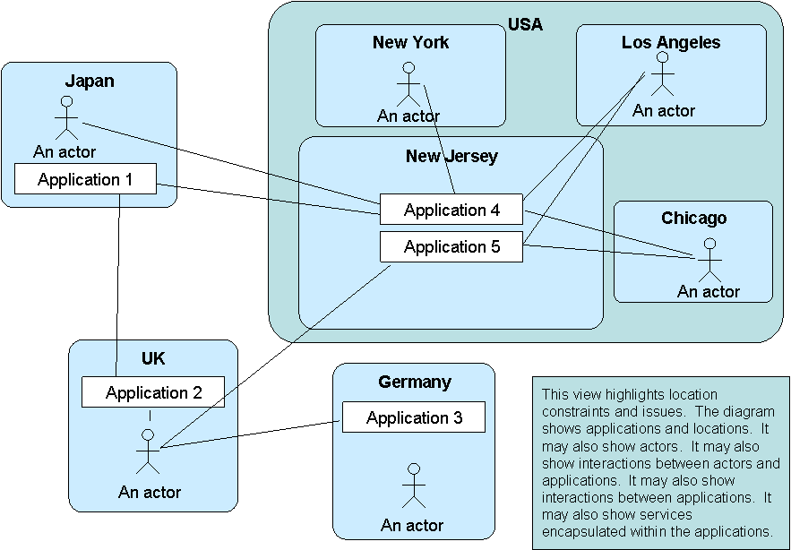
Example Application & User Location Diagram (part 2)
Notes:
An example of an elaboration is provided

Slide 83
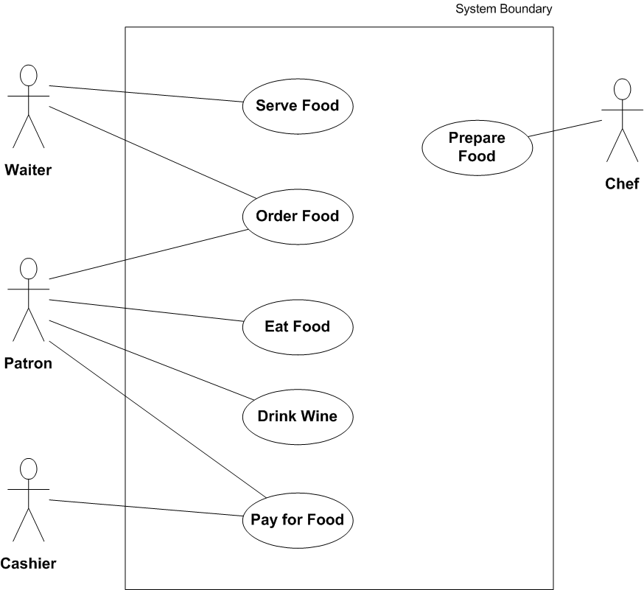
Application Use Case Diagram
Source: wikipedia.org
Notes:
Application Use-Case Diagram
The example on the slide shows a very simple Use Case diagram for a restaurant.
An Application Use-Case diagram displays the relationships between consumers and providers of application services. Application services are consumed by actors or other application services and the Application Use-Case diagram provides added richness in describing application functionality by illustrating how and when that functionality is used.
The purpose of this diagram is to help to describe and validate the interaction between actors and their roles with applications. As the architecture progresses, the use-case can evolve from functional information to include technical realization detail.
Application use-cases can also be re-used in more detailed systems design work.

Slide 84
Enterprise Manageability Diagram
The Enterprise Manageability diagram shows how one or more applications interact with application and technology components that support operational management of a solution.
Analysis can reveal duplication and gaps, and opportunities in the IT service management operation of an organization.
Notes:
The Enterprise Manageability diagram shows how one or more applications interact with application and technology components that support operational management of a solution.
This diagram is really a filter on the Application Communication diagram, specifically for enterprise management class software.

Slide 85
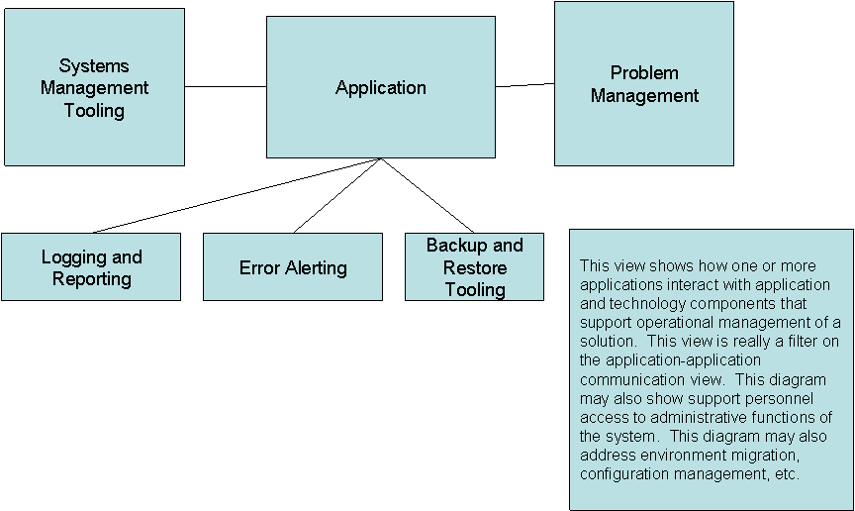
Example Enterprise Manageability Diagram
Notes:
Analysis can reveal duplication and gaps, and opportunities in the IT service management operation of an organization.
This is part of the Governance Extension within the Metamodel

Slide 86
Process/Application Realization Diagram
The purpose of this diagram is to depict the sequence of events when multiple applications are involved in executing a business process.
It enhances the Application Communication diagram by augmenting it with any sequencing constraints, and hand-off points between batch and real-time processing.
Notes:
The purpose of the Process/System Realization diagram is to clearly depict the sequence of events when multiple applications are involved in executing a business process.
It enhances the Application Communication diagram by augmenting it with any sequencing constraints, and hand-off points between batch and real-time processing.
It should be used to identify complex sequences that could be simplified, and identify possible rationalization points in the architecture in order to provide more timely information to business users.
It may also identify process efficiency improvements that may reduce interaction traffic between applications.

Slide 87
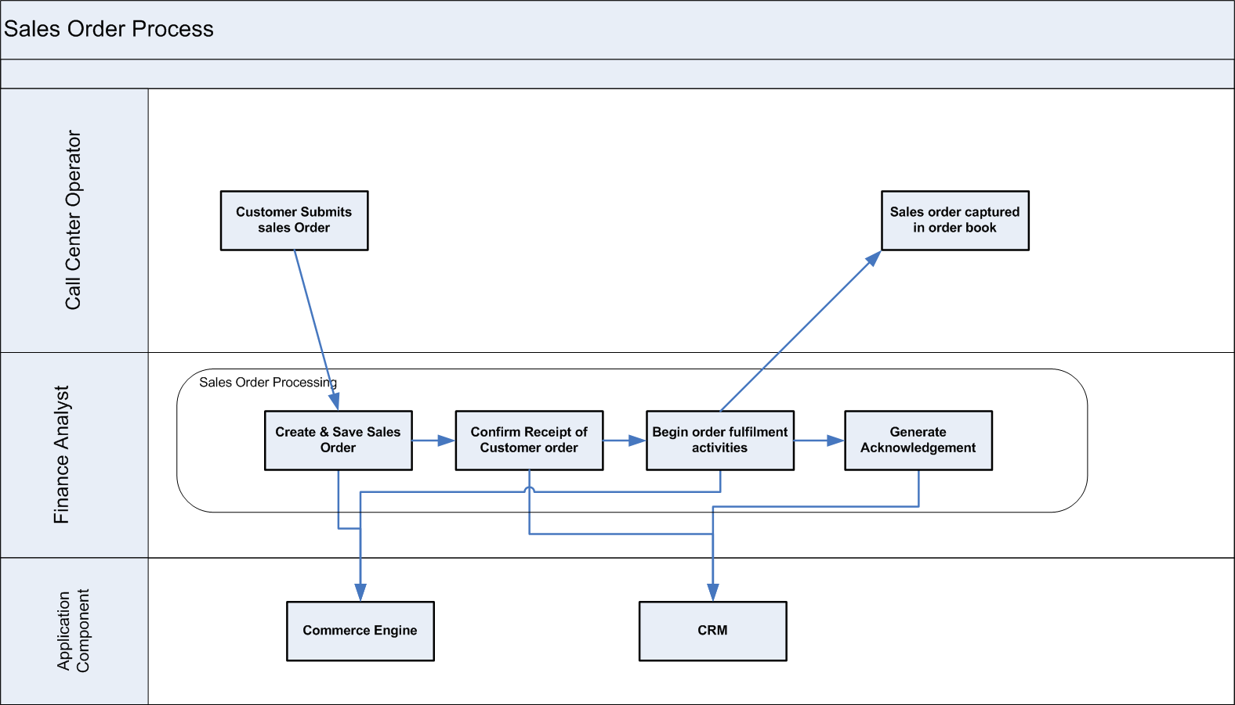
Example Process/Application Realization Diagram
Notes:
The decision on diagram form will depend on the level of detail and formality. Generally the non-formal view is best suited to stakeholders.

Slide 88
Software Engineering Diagram
The Software Engineering diagram breaks applications into packages, modules, services, and operations from a development perspective.
It enables more detailed impact analysis when planning migration stages, and analyzing opportunities and solutions.
It is ideal for application development teams and application management teams when managing complex development environments.
Notes:
The Software Engineering diagram breaks applications into packages, modules, services, and operations from a development perspective.
It enables more detailed impact analysis when planning migration stages, and analyzing opportunities and solutions.
It is ideal for application development teams and application management teams when managing complex development environments.

Slide 89
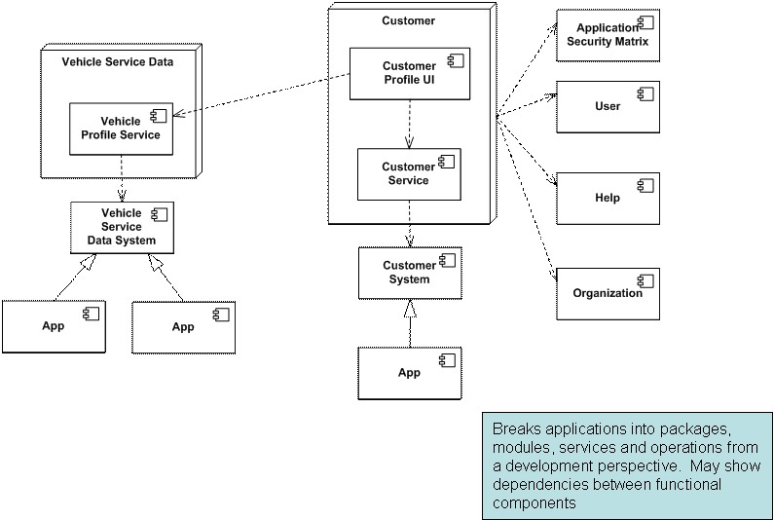
Example Software Engineering Diagram
Notes:
The Software Engineering diagram breaks applications into packages, modules, services, and operations from a development perspective.
It enables more detailed impact analysis when planning migration stages, and analyzing opportunities and solutions.
It is ideal for application development teams and application management teams when managing complex development environments.

Slide 90
Application/Migration Diagram
The Application Migration diagram identifies application migration from baseline to target application components.
It enables a more accurate estimation of migration costs
It should be used to identify temporary applications, staging areas, and the infrastructure required to support migrations
Notes:
The Application Migration diagram identifies application migration from baseline to target application components.
It enables a more accurate estimation of migration costs by showing precisely which applications and interfaces need to be mapped between migration stages.
It would identify temporary applications, staging areas, and the infrastructure required to support migrations (for example, parallel run environments, etc).

Slide 91
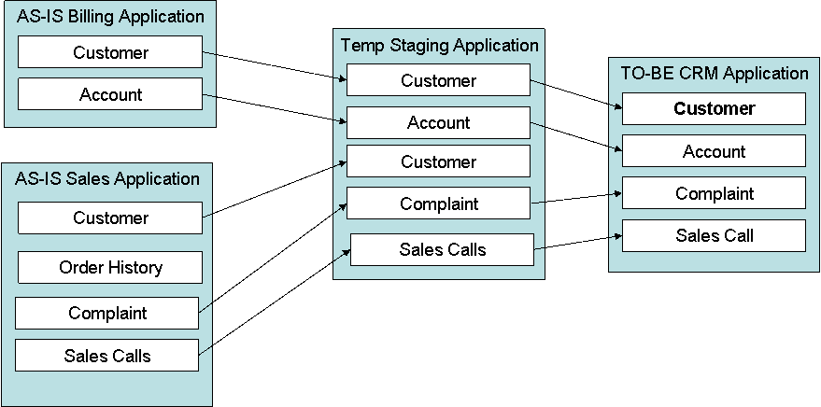
Example Application/Migration Diagram

Slide 92
Software Distribution Diagram
This diagram is a composite of the Software Engineering diagram and the Application-User Location diagram.
Depending on the circumstances, this diagram alone may be sufficient, or may not be needed.
Notes:
The Software Distribution diagram shows how application software is structured and distributed across the estate. It is useful in systems upgrade or application consolidation projects.
This diagram shows how physical applications are distributed across physical technology and the location of that technology.
This enables a clear view of how the software is hosted, but also enables managed operations staff to understand how that application software is maintained once installed.

Slide 93
Phase C
Phase D: Technology Architecture – Catalogs, Matrices and Diagrams
TOGAF is a registered trademark of The Open Group in the United States and other countries
Notes:
See section 2.3.4.2 of the Pocket Guide and Chapter 11 of TOGAF.
The block diagram shows we are on Application Architecture, one of the four major types of architecture addressed by TOGAF (the colours chosen match those of the metamodel)

Slide 94
Catalogs, Matrices and Diagrams
D
Catalogs
Technology Standards catalog
Technology Portfolio catalog
Matrices
Application/Technology matrix
Diagrams
Environments and Locations diagram
Platform Decomposition diagram
Processing diagram
Networked Computing/Hardware diagram
Communications Engineering diagram
Notes:
Another view on the Catalogs/Matrices and Diagrams for this Phase.

Slide 95
Catalogs
Technology Standards catalog
Technology Portfolio catalog

Slide 96
Catalogs
Catalog | Purpose
Technology Standards Catalog | This documents the agreed standards for technology across the enterprise covering technologies, and versions, the technology lifecycles, and the refresh cycles for the technology. It can be implemented as an extension to the Technology Portfolio Catalog and thus will share the same metamodel entities: Platform Service, Logical Technology Component, Physical Technology Component
Technology Portfolio Catalog | This catalog identifies and list all the technology in use across the enterprise, including hardware, infrastructure software, and application software. An agreed technology portfolio supports lifecycle management of technology products and versions and also forms the basis for definition of technology standards It contains the following metamodel entities: Platform Service, Logical Technology Component, Physical Technology Component
Notes:
The Technology Standards catalog Depending upon the organization, this may also include location or business domain-specific standards information.
This catalog provides a snapshot of the enterprise standard technologies that are or can be deployed, and also helps identify the discrepancies across the enterprise.
If technology standards are currently in place, apply these to the Technology Portfolio catalog to gain a baseline view of compliance with technology standards.
.
The Technology Portfolio catalog provides a foundation on which to base the remaining matrices and diagrams. It is typically the start point of the Technology Architecture phase.
Technology registries and repositories also provide input into this catalog from a baseline and target perspective.
Technologies in the catalog should be classified against the TOGAF Technology Reference Model (TRM) - see Part VI, Foundation Architecture: Technical Reference Model - extending the model as necessary to fit the classification of technology products in use.

Slide 97
Matrices
Application/Technology matrix
Notes:
This was called the System/Technology matrix for TOGAF 9

Slide 98
Application/Technology Matrix
The Application/Technology matrix documents the mapping of applications to the technology platform.
The Application/Technology matrix shows:
  Logical/Physical Application Components
  Services, Logical Technology Components, and Physical Technology Components
  Physical Technology Component realizes Physical Application Component relationships
Notes:
The Application/Technology matrix documents the mapping of applications to the technology platform.
This matrix should be aligned with and complement one or more platform decomposition diagrams.
The Application/Technology matrix shows:
Logical/Physical Application Components
Services, Logical Technology Components, and Physical Technology Components
Physical Technology Component realizes Physical Application Component relationships

Slide 99
Example Application/Technology Matrix
LOGICAL APPLICATION COMPONENT | PHYSICAL TECHNOLOGY COMPONENT | SERVER ADDRESS | IP ADDRESS
ABM | Web server - node 1 | F01ws001@host.com | 10.xx.xx.xx
 | Web server - node 2 | F01ws002@host.com | 10.xx.xx.xx
 | Web server - node 3 | F01ws003@host.com | 10.xx.xx.xx
 | App server – node 1 | F02as001@host.com | 10.xx.xx.xx
 | App server – node 2 | F02as002@host.com | 10.xx.xx.xx
 | App server – node 3 | F02as003@host.com | 10.xx.xx.xx
 | Database server (production) | F02dbp001@host.com | 10.xx.xx.xx
 | Database server (stating) | F03dbs001@host.com | 10.xx.xx.xx
Load balancer and Dispatcher | Dispatcher server | F03nd001@host.com | 242.xx.xx.xx
Notes:
The System/Technology matrix documents the mapping of business systems to technology platform.
This matrix should be aligned with and complement one or more platform decomposition diagrams.
The System/Technology matrix shows:
Logical/Physical Application Components
Services, Logical Technology Components, and Physical Technology Components
Physical Technology Component realizes Physical Application Component relationships

Slide 100
Example Application/Technology Matrix
TECH FUNCTION | HARDWARE LOGICAL | HARDWARE PHYSICAL | SOFTWARE LOGICAL | SOFTWARE PHYSICAL
Load balancing | Name – Balancer Vendor - IBM Server Type – eServer Clustered – No No. of Nodes – N/A Server logical address - d04lb01@host.com Maintenance Window – Sun 0100 to 0300 | Model/Type – IBM P7xx Serial Number – 1S4568 Processor Type - RISC Power p5 Number of Processors - 8 way Memory - 1GB Hard drive - 40 GB IP - 11.xx.xx.xx | Product- IBM Load balance manager Vendor - IBM OS – UNIX | SW Components – LB v3.2 (list all the other components of the SW product) AIX 10.2.1 License Type - Enterprise wide license License expiry date - 12/31/2014

Slide 101
Example System/Technology Matrix
APPLICATION COMPONENT | DEPLOYMENT UNIT | TECHNOLOGY COMPONENT
Load Balancer | Smart dispatch v1.2 (both installation and execution code) | Load balancing server (d03lb001@host.com)
Commerce pages | HTML code Applets JSP | Web Server cluster (d03ws001@host.com, d03ws002@host.com, d03ws003@host.com)
Commerce Engine | Order Entry (both installation and execution code) Shopping Cart (both installation and execution code) | Application Server (d03as001@host.com, d03as002@host.com)

Slide 102
Diagrams
Environments and Locations diagram
Platform Decomposition diagram
Processing diagram
Networked Computing/Hardware diagram
Communications Engineering diagram
Notes:
These diagrams will be discussed in the slides that follow.

Slide 103
Environments and Locations Diagram
Depicts which locations host which applications
Identifies what technologies and/or applications are used at which locations
Identifies the locations from which business users typically interact with the applications.
It should also show the existence and location of different deployment environments
  including non-production environments, such as development and pre production.
Notes:
The Environments and Locations diagram depicts which locations host which applications, identifies what technologies and/or applications are used at which locations, and finally identifies the locations from which business users typically interact with the applications.
This diagram should also show the existence and location of different deployment environments, including non-production environments, such as development and pre production.

Slide 104
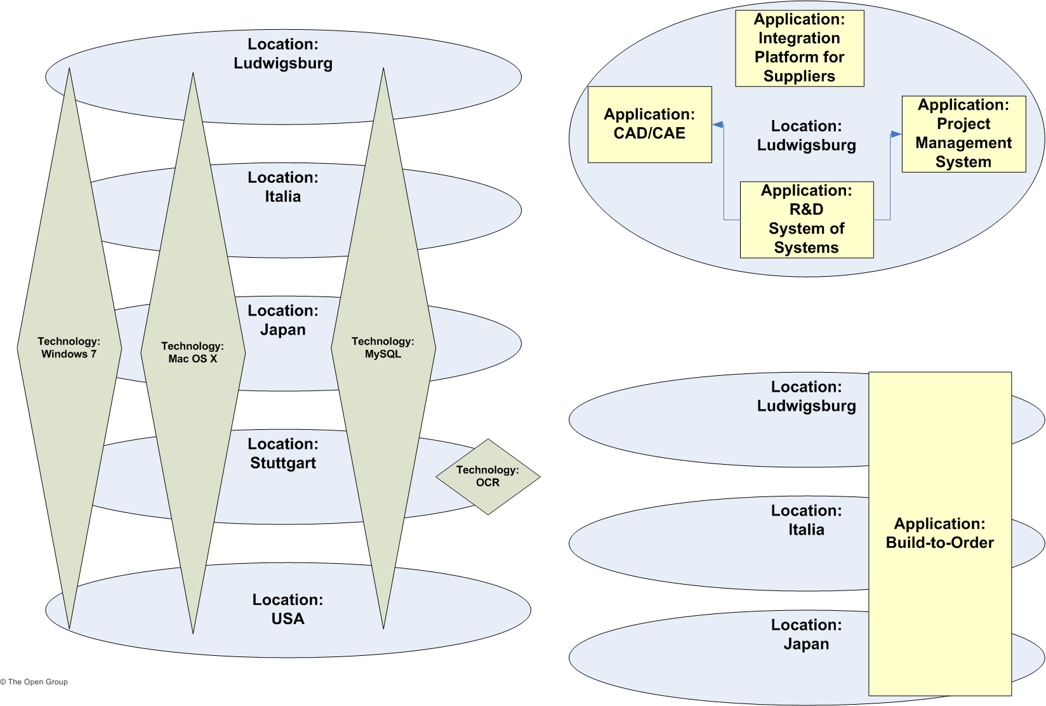
Example Environments and Locations Diagram
Notes:
The Environments and Locations diagram depicts which locations host which applications, identifies what technologies and/or applications are used at which locations, and finally identifies the locations from which business users typically interact with the applications.
This diagram should also show the existence and location of different deployment environments, including non-production environments, such as development and pre production.

Slide 105
Platform Decomposition Diagram
The Platform Decomposition diagram depicts the technology platform that supports the operations of the Information Systems Architecture.
The diagram covers all aspects of the infrastructure platform and provides an overview of the enterprise's technology platform.
Notes:
The Platform Decomposition diagram depicts the technology platform that supports the operations of the Information Systems Architecture. The diagram covers all aspects of the infrastructure platform and provides an overview of the enterprise's technology platform. The diagram can be expanded to map the technology platform to appropriate application components within a specific functional or process area. This diagram may show details of specification, such as product versions, number of CPUs, etc. or simply could be an informal "eye-chart" providing an overview of the technical environment.

Slide 106
Example Platform Decomposition Diagram
Platform Decomposition (Application Support)
Hardware
Software
Logical Technology Components
Physical Technology Components
Logical Technology Components
Physical Technology Components
Tech Function
Tech Function
Tech Function
Tech Function
Web Server
Layer
Web server layer
Web Server Layer
Web Server Layer
Application Layer
Application Layer
Application Layer
Application Layer
Database Layer
Database Layer
Database Layer
Database Layer
Attributes
Name
Model/Type
Clusters
Number of Components
Vendor
Server Type (mainframe, Mid range, RISC, Intel)
Server logical name
IP Address etc
Attributes
Product Name
Vendor
OS
SW components
License Type
License Expiry etc
Notes:
The diagram should clearly show the enterprise applications and the technology platform for each application area can further be decomposed as follows:
Hardware:
Logical Technology Components (with attributes)
Physical Technology Components (with attributes)
Software:
Logical Technology Components (with attributes)
Physical Technology Components (with attributes)
Depending upon the scope of the enterprise architecture work, additional technology cross-platform information (e.g., communications, telco, and video information) may be addressed.

Slide 107
Processing Diagram
The Processing diagram focuses on deployable units of code/configuration and how these are deployed onto the technology platform.
The Processing diagram addresses the following:
  Which set of application components need to be grouped to form a deployment unit
  How one deployment unit connects/interacts with another (LAN, WAN, and the applicable protocols)
  How application configuration and usage patterns generate load or capacity requirements for different technology components
The organization and grouping of deployment units depends on separation concerns of the presentation, business logic, and data store layers and service-level requirements of the components.
Notes:
The Processing diagram focuses on deployable units of code/configuration and how these are deployed onto the technology platform. A deployment unit represents grouping of business function, service, or application components. The Processing diagram addresses the following:
Which set of application components need to be grouped to form a deployment unit
How one deployment unit connects/interacts with another (LAN, WAN, and the applicable protocols)
How application configuration and usage patterns generate load or capacity requirements for different technology components
The organization and grouping of deployment units depends on separation concerns of the presentation, business logic, and data store layers and service-level requirements of the components. For example, presentation layer deployment unit is grouped based on the following:
Application components that provide UI or user access functions
Application components that are differentiated by location and user roles

Slide 108

Example Processing Diagram
Open
Internet
DMZ
Internet Zone
Intranet Zone
File Explorer, HTML, Images
(DFS Distributed File System
Server)
Order capture
(DB server)
Order Entry &
Shopping
Cart
(Application Server
cluster with 2 nodes)
HTML Code (Web
server cluster with
2 nodes)
Load
Balancer
Code
App
Server
DB
Messaging
Server
Over LAN
HTTP
Firewall
Firewall
Firewall
Notes:
There are several considerations to determine how application components are grouped together. Each deployment unit is made up of sub-units, such as:
Installation: Part that holds the executable code or package configuration (in case of packages).
Execution: Application component with its associated state at run time.
Persistence: Data that represents the persistent state of the application component.
Finally, these deployment units are deployed on either dedicated or shared technology components (workstation, web server, application server, or database server, etc.). It is important to note that technology processing can influence and have implications on the services definition and granularity.

Slide 109
Network Computing Hardware Diagram
The purpose of this diagram is to show the "as deployed" logical view of logical application components in a distributed network computing environment.
The diagram is useful for the following reasons:
  Enable understanding of which application is deployed where
  Establishing authorization, security, and access to these technology components
  Understand the Technology Architecture that support the applications during problem resolution and troubleshooting
  Isolate performance problems encountered and perform necessary upgrade to specific physical technology components
  Identify areas of optimization
  Enable application/technology auditing and prove compliance
  Serve as an important tool supporting effective change management
Notes:
The purpose of this diagram is to show the "as deployed" logical view of logical application components in a distributed network computing environment. The diagram is useful for the following reasons:
Enable understanding of which application is deployed where in the distributed network computing environment
Establishing authorization, security, and access to these technology components
Understand the Technology Architecture that support the applications during problem resolution and troubleshooting
Isolate performance problems encountered by applications, determine whether it is application code-related or technology platform-related, and perform necessary upgrade to specific physical technology components
Identify areas of optimization as and when newer technologies are available which will eventually reduce cost
Enable application/technology auditing and prove compliance with enterprise technology standards
Serve as an important tool to introduce changes to the Technology Architecture, thereby supporting effective change management
Establish traceability and changing application end-point address while moving application either from a shared environment to a dedicated environment or vice versa

Slide 110
Example Network Computing Hardware Diagram
DMZ
Internet Zone
Intranet Zone
Application
Server cluster (node 3)
Database
(ABM
Production)
Database
(ABM
Staging)
Load
Balancer
and
Dispatcher
Web
server
cluster
Application
Server cluster (node 3)
Web
server
cluster
App Server
cluster - node 3
(ABM)
Web
server
cluster-
node 3
(ABM)
DFS Distributed File
System (html,
images)
Application
Server (Order
Engine)
Database
App
Server
DB
Load
Balancer
and
Dispatcher
Web server cluster
Web server
cluster-node 2
(eCommerce)
App Server
Firewall
Firewall
Firewall

Slide 111
Communications Engineering Diagram
The Communications Engineering diagram describes the means of communication between assets in the Technology Architecture
It takes logical connections between client and server components and identifies network boundaries and network infrastructure required to physically implement those connections.
It does not describe the information format or content, but addresses protocol and capacity issues.
Notes:
The Communications Engineering diagram describes the means of communication - the method of sending and receiving information - between these assets in the Technology Architecture; insofar as the selection of package solutions in the preceding architectures put specific requirements on the communications between the applications.
The Communications Engineering diagram will take logical connections between client and server components and identify network boundaries and network infrastructure required to physically implement those connections. It does not describe the information format or content, but will address protocol and capacity issues.

Slide 112
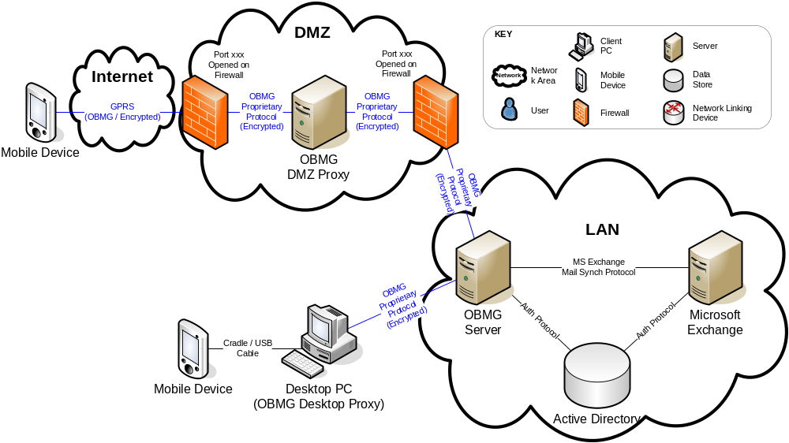
Communications Engineering Diagram
Notes:
The Communications Engineering diagram describes the means of communication - the method of sending and receiving information - between these assets in the Technology Architecture; insofar as the selection of package solutions in the preceding architectures put specific requirements on the communications between the applications.
The Communications Engineering diagram will take logical connections between client and server components and identify network boundaries and network infrastructure required to physically implement those connections. It does not describe the information format or content, but will address protocol and capacity issues.

Slide 113
Phase C
Phase E: Opportunities & Solutions – Catalogs, Matrices and Diagrams
TOGAF is a registered trademark of The Open Group in the United States and other countries
Notes:
See section 2.3.4.2 of the Pocket Guide and Chapter 11 of TOGAF.
The block diagram shows we are on Application Architecture, one of the four major types of architecture addressed by TOGAF (the colours chosen match those of the metamodel)

Slide 114
Opportunities & Solutions
Catalogs, Matrices and Diagrams
E
Catalogs
Matrices
Diagrams
Project Context diagram
Benefits diagram
Notes:
Catalogs capture inventories of the core assets of the Business. Catalogs are hierarchical in nature and capture the decomposition of a metamodel entity and also decompositions across related metamodel entities (e.g. organization → actor).
Catalogs form the raw material for development of matrices and diagrams and also act as a key resource for portfolio managing business and IT capability.
The Catalogs listed above are identified as being core to the definition of a Business Architecture
The structure of catalogs is based on the attributes of the contained metamodel entities as defined in Part IV.
Outcome:
Business Architecture Catalogs (a component of the Architecture Report)‏

Slide 115
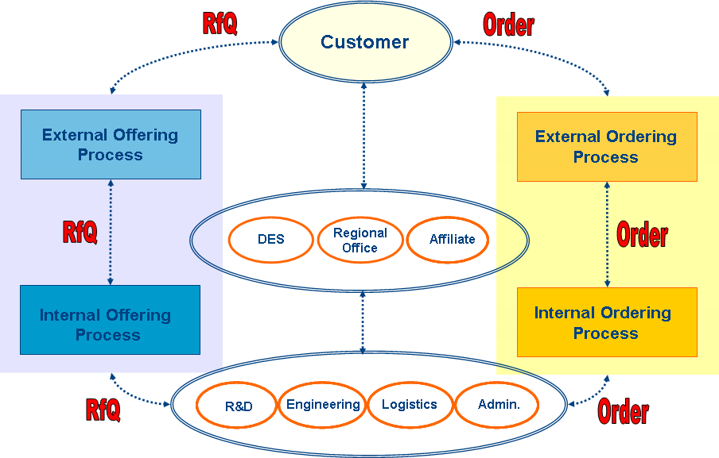
Project Context Diagram
Notes:
A Project Context diagram shows the scope of a work package to be implemented as a part of a broader transformation roadmap. The Project Context diagram links a work package to the organizations, functions, services, processes, applications, data, and technology that will be added, removed, or impacted by the project.
The Project Context diagram is also a valuable tool for project portfolio management and project mobilization.

Slide 116
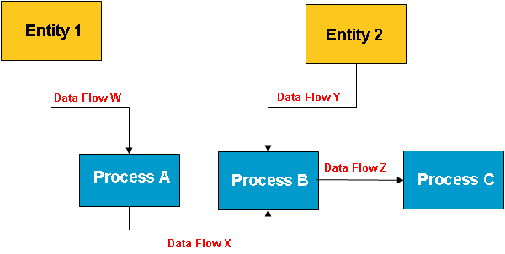
Project Context Diagram

Slide 117
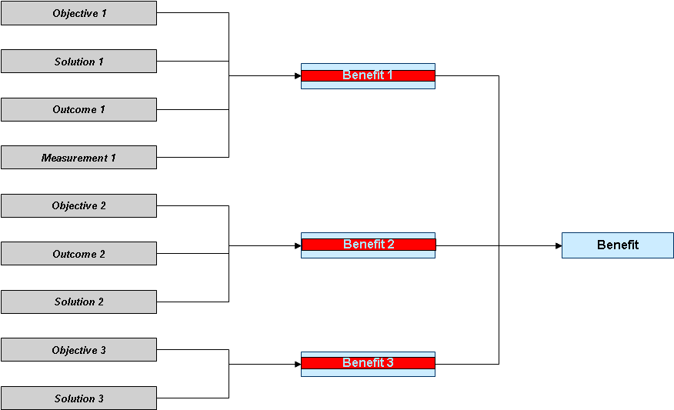
Benefits Diagram
Notes:
The Benefits diagram shows opportunities identified in an architecture definition, classified according to their relative size, benefit, and complexity. This diagram can be used by stakeholders to make selection, prioritization, and sequencing decisions on identified opportunities.

Slide 118
Phase C
Requirements Management – Catalogs, Matrices and Diagrams
TOGAF is a registered trademark of The Open Group in the United States and other countries
Notes:
See section 2.3.4.2 of the Pocket Guide and Chapter 11 of TOGAF.
The block diagram shows we are on Application Architecture, one of the four major types of architecture addressed by TOGAF (the colours chosen match those of the metamodel)

Slide 119
Requirements Management
Catalogs, Matrices and Diagrams
R
Catalogs
Requirements Catalog
Matrices
Diagrams
Notes:
Catalogs capture inventories of the core assets of the Business. Catalogs are hierarchical in nature and capture the decomposition of a metamodel entity and also decompositions across related metamodel entities (e.g. organization → actor).
Catalogs form the raw material for development of matrices and diagrams and also act as a key resource for portfolio managing business and IT capability.
The Catalogs listed above are identified as being core to the definition of a Business Architecture
The structure of catalogs is based on the attributes of the contained metamodel entities as defined in Part IV.
Outcome:
Business Architecture Catalogs (a component of the Architecture Report)‏

Slide 120
Catalogs
Catalog
Purpose
Requirements
Catalog
The Requirements catalog captures things that the enterprise needs to do to meet its objectives. Requirements generated from architecture engagements are typically implemented through change initiatives identified and scoped during Phase E (Opportunities & Solutions). Requirements can also be used as a quality assurance tool to ensure that a particular architecture is fit-for-purpose (i.e., can the architecture meet all identified requirements).
The Requirements catalog contains the following metamodel entities:
* Requirement
* Assumption
* Constraint
* Gap
Notes:
Organization/Actor Catalog
The Organization/Actor catalog can be referenced when developing requirements in order to test for completeness.
Driver/Goal/Objectives catalog
Publishing a definitive breakdown of drivers, goals, and objectives allows change initiatives within the enterprise to identify synergies across the organization (e.g., multiple organizations attempting to achieve similar objectives), which in turn allow stakeholders to be identified and related change initiatives to be aligned or consolidated.
Role Catalog
If roles are defined, understood, and aligned across organizations and applications, this allows for a more seamless user experience and generally more secure applications, as administrators do not need to resort to workarounds in order to enable users to carry out their jobs.
In addition to supporting security definition for the enterprise, the Role catalog also forms a key input to identifying organizational change management impacts, defining job functions, and executing end-user training.
As each role implies access to a number of business functions, if any of these business functions are impacted, then change management will be required, organizational responsibilities may need to be redefined, and retraining may be needed.

Slide 121
Resources
A set of downloadable templates is available
  http://www.opengroup.org/bookstore/catalog/i093.htm

Slide 122
Sample Catalogs, Matrices and Diagrams
TOGAF is a registered trademark of The Open Group in the United States and other countries
Notes:
This is material added to part III in TOGAF 9, supporting the ADM with a collection of guidelines and techniques.

